Slide 1
A grounded theory of familial adjustment in the transition to adulthood for autistic youth with intellectual disability: a parental perspective
Dr. Kalem Mahon UL: Dr. Barry Coughlan & Dr. Elaine Rogers
Clinical Psychologist SMH: Dr. Anita Hyland & Isabelle O’Donoghue

Slide 2
A Note on Language…
Autistic person/youth is used in this presentation
This is recommended by the The National Institute for Health and Care Excellence (NICE, 2016)

Slide 3
Why This Research?
The transition to adulthood can be a significant time in the lives of autistic individuals and their families.
  Parents of autistic youth can experience elevated caregiving demands in the transition to adulthood (see Hendricks & Wehman, 2009).
  Caregivers can report high levels of stress and anxiety while securing systems of support for autistic youth (Newsome, 2008).
There is limited research on the transition to adulthood in an Irish context.

Slide 4
Systematic Review: Parents Experience of Transition
Research Questions:
  Parents support/caregiving roles
  Impact of transition on parents
Search Strategy
  Population, Exposure, Outcome (PEO)
  Five databases (PsychInfo; CINAHL; Education Source; Medline; Academic Search Complete)
Screening
PRISMA (Moher et al., 2009)
Quality: Critical Appraisal Skills Programme (CASP UK, 2013)
Data synthesis: Thematic Synthesis (Thomas & Harding, 2009)

Slide 5
Systematic Review – Findings
Findings synthesised from 29 qualitative studies with at least 489 parent participants
Studies were conducted across nine countries over an eight year period (2012-2020).
Notes:
1.

Slide 6
Systematic Review – Parent Support/Caregiving Roles
Holding responsibility for coordinating services and supports
Supporting and developing their youth’s independence
  Balancing the push for independence and need for support
  Tentatively encouraging and supporting youth’s autonomy
  Teaching skills to support youth’s independence
Advocating for youth to ensure adequate support and equal opportunities
Planning and preparing for youth’s adult lives
  Planning for youth’s transition
  Accessing and preparing youth for adult roles
  Preparing for their youth’s long-term future
Caregiving for youth beyond transition
  Providing practical support to youth in adulthood
  Providing social and emotional support to youth in adulthood

Slide 7
Systematic Review – Impact on Parents
Transition can lead to psychological and emotional challenges for parents
Transition can impact on parent's life circumstances
Transition can lead to changes in parent's relationships with their youth
Parents adopt personal coping strategies and seek support from others to manage the impact of transition

Slide 8
The Present Study: A Grounded Theory of Familial Adjustment
Research Question: What are parents experiences of, and perspectives on, the complexities of autistic youth transitioning to adulthood?
Data collection:
  Semi-structured interviews
  7 parents of autistic youth with an intellectual disability
  All parents agreeing to participate were from one organization
Analysis:
  Constructivist Grounded Theory (Charmaz, 2014)
  Initial and Focused Coding
  Constant Comparison
  Memo Writing
  Theory Development

Slide 9
Findings: The Transition Context
Service transition
  A move from school to adult day and/or residential services
  A shift from child clinical supports to adult clinical supports
Developmental transition
  A change in expectations of youth as they become adults
  Legal changes

Slide 10
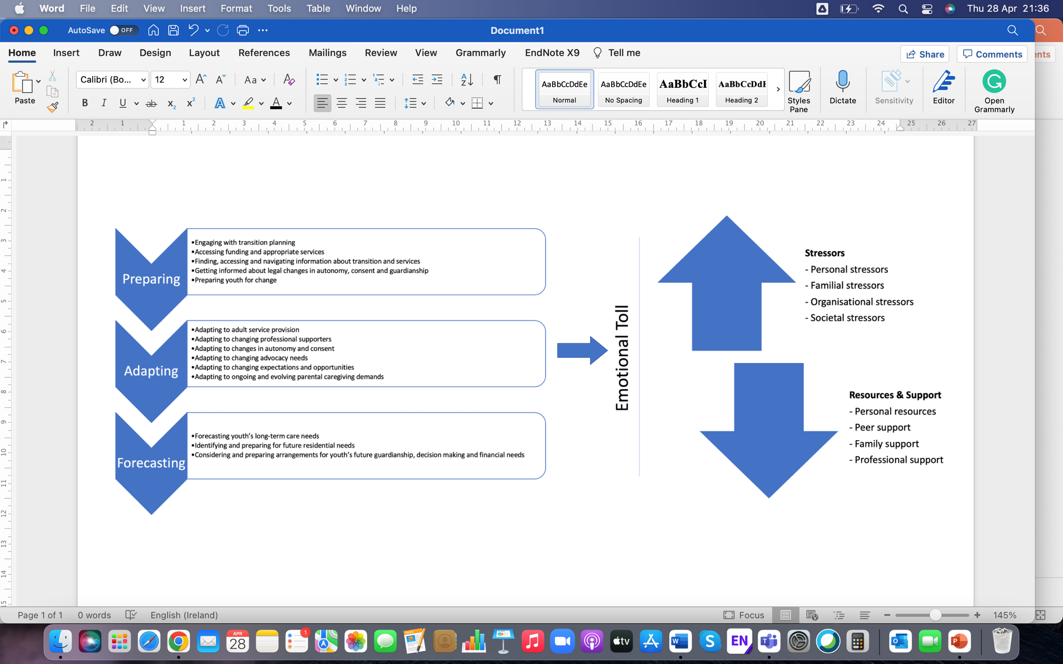
The Grounded Theory: Familial adjustment in the transition to adulthood

Slide 11
Preparing
1. Engaging with transition planning
  Instigating transition planning
  Timeliness of transition planning
2. Accessing funding and appropriate services
  Navigating funding processes
  Limited choice
  Services organizing practicalities of placements
3. Finding, accessing and navigating information about transition and services
  Getting information from peers, and professionals in schools and adult services
  No one place for accessing information
4. Getting informed about legal changes in autonomy, consent and guardianship
  Uncertainty regarding parent’s role in consent
5. Preparing youth for change
  Developing youth’s readiness for change
  Teaching skills for adult life

Slide 12
Adapting
1. Adapting to adult service provision
  Some experiencing a gap between child and adult services
  Handover
  Parent-service collaboration
2. Adapting to changing professional supporters
  Developing trust in staff
3. Adapting to changes in autonomy and consent
  Abrupt shift vs gradual approach to changes in autonomy
  Can be a challenge and a positive
  Consent and decision-making capacity
4. Adapting to changing advocacy needs
  Advocating for service access
5. Adapting to changing expectations and opportunities
  Relationships
  Identifying work opportunities
6. Adapting to ongoing and evolving parental caregiving demands
  A loss of roles
  Providing ongoing care

Slide 13
Forecasting
1. Forecasting youth’s long-term care needs
  Managing youth’s care as parents age
2. Identifying and preparing for future residential needs
  Concern over potential future residential move
  Planning in advance
3. Considering and preparing arrangements for youth’s future guardianship, decision making and financial needs

Slide 14
Emotional Toll - Stressors
1. Personal Stressors
  Personal preferences for sameness impacted by uncertainty
  Personal health struggles
2. Familial Stressors
  Residential transition
3. Organisational Stressors
  Difficulties with planning
  Some experiencing a gap in service provision
  Ongoing changes to service provision
  Information
4. Societal Stressors
  Covid-19 – inaccessibility of familiar places

Slide 15
Emotional Toll – Resources & Support
1. Personal Resources
  Perseverance, resilience, seeing challenges as tasks to work through
  Work negotiations
2. Peer Support
  Connecting with peers for emotional support or practical information
  A desire for formal support groups
3. Family Support
  Offers and efforts to help
4. Professional Support
  Schools and adult services
  Online training and resources
  A desire for parent counselling

Slide 16
Familial adjustment in the transition to adulthood

Slide 17
Potential Implications
Theoretical model
  A start in mapping the area for the transition to adulthood for families of autistic youth
  Provides a starting framework for services and organisations
  Outlines stressors that can be targeted and relevant supports that can be fostered
Areas to address from a clinical and policy perspective
  Transition planning – timing and involvement
  Accessibility of adult services
  Changes to decision making expectations
Future Research
  Further exploration of the theory’s/model’s utility across various regions and with differing populations
  Quantitative research to explore the factors contributing to adjustment
  Further exploration of decision-making changes in adulthood and/or assisted decision making as this is formalised in Ireland

Slide 18
References
National Institute for Health and Care Excellence (NICE). (2016). https://www.nice.org.uk/corporate/ecd1
Hendricks, D. R., and Wehman, P. (2009). Transition From School to Adulthood for Youth With Autism Spectrum Disorders: Review and Recommendations. Focus on Autism and Other Developmental Disabilities. 10.1177/1088357608329827
Newsome, W. (2008). Parents perceptions during periods of transition: Implications for social workers serving families coping with autism. Journal of Family Social Work, 5(2), 17–31. doi:10.1300/J039v05n02_03
Critical Appraisal Skills Programme (2018). CASP Qualitative Checklist. [online] Available at: https://casp-uk.net/casp-tools-checklists/ Accessed: July 2021
Thomas, J., and Harden, A. (2008). Methods for the thematic synthesis of qualitative research in systematic reviews. BMC Medical Research Methodology, 8(45). https://doi.org/10.1186/1471-2288-8-45
Moher, D., Liberati, A., Tetzlaff, J., Altman, D. G., (2009). Preferred Reporting Items for Systematic Reviews and Meta-Analyses: The PRISMA Statement. PLoS Med 6(7). Doi:10.1371/journal.pmed1000097
Charmaz, K. (2014). Constructing Grounded Theory (2nd Ed.). London, UK: SAGE Publications Ltd.

Slide 19
Any Questions?

