Slide 1



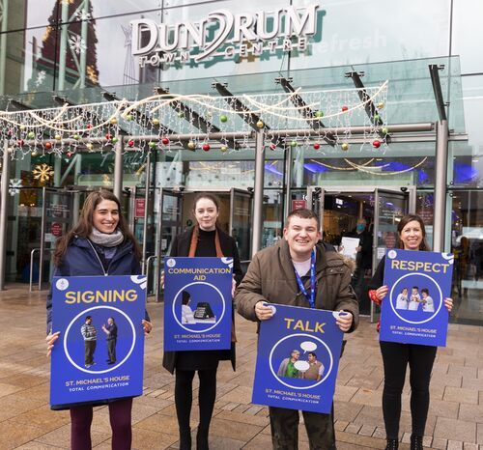
Total Communication Project with Dundrum Town Centre
SMH Research Day
27th February 2023

Slide 2

Introduction to Project
The aim is to create a more inclusive Total Communication approach for customers in Dundrum Town Centre (DTC)
Strand 1: People
Strand 2: Place
First Initiative of its kind in a shopping centre in Ireland
Led by SMH SLT Dept
SMH SLT Dept Research Project
Notes:
Jenny speaking- DTC AND SMH long standing established partnership
SLT dept have developed as a research project focusing on providing Total Communication training to support social inclusion
Data collected will inform the Total Communication approach in Dundrum
Strand 1 People - a bespoke Total Communication training package for DTC staff
Strand 2 Place – a report on recommendations for the Total Communication environment (signage, visual supports, accessible information)

Slide 3
Introduction to Project
DTC and SMH established Charity Partnership
In development with DTC, SMH Communications and SLT dept over 2 years
DTC want to develop staff skills & knowledge to support customers with additional needs including ID
SLT dept have developed as a research project focusing on providing Total Communication training to support social inclusion
Notes:
Jenny speaking- Impact of covid and staff resources on project roll out

Slide 4

Social Inclusion
the importance for services supporting people with disabilities to promote the development of natural supports within neighbourhoods/localities
Barriers to social inclusion
  Pre-existing attitudes
  Fear of the new
Need for services to link with mainstream organisations to provide knowledge and skills to promote universal access in their settings.
Total Communication
Notes:
Sasha speaking
Recent research is focusing more on the concept of social inclusion and the importance for services supporting people with disabilities to promote the development of natural supports within neighbourhoods/localities. Some barriers to social inclusion within the wider community include pre-existing attitudes and fear of the new. To promote social inclusion we need to support people with disabilities to be active and visible in their localities in day to day life. We are all familiar with the concept of universal design where the environment is one that provides access for all, this is why it is important for services to make strategic links with mainstream organisations to provide these organisations with the knowledge and skills to promote universal access in their settings. For us we have focused on the use of a Total Communication approach where all modes of communication are valued, frequent people in the environment have an awareness of how to be a supportive communciation partner and the different modes people may use, and a Total communication environment is in place..

Slide 5
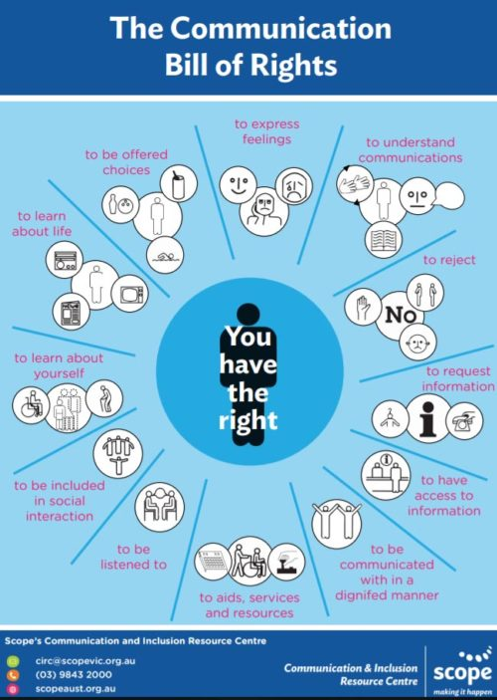
Communication Bill of Rights
Notes:
Communication has many functions in order for people to access the world around them. The right to understand, to learn, to be included in social interactions, to access services such as completing an application form, to request information such as closing times for a shop etc. The UNCRPD protects everyone's’ rights as it states that countries, their governments and the public all have a role to play in upholding the rights of people with an intellectual disability, particularly as we know from the last slide that this can often result in a communication disability.

Slide 6
Aims of our Project
The aim of this project is to create a more inclusive Total Communication Approach in DTC
Aim to achieve this by determining the following re: communication supports
  The Need
  The Type
  How to provide to DTC
Notes:
Jenny speaking

Slide 7
How we are doing this
SMH Ethics Approval and Research bursary
Survey & Focus Group research design
Participants:
  Adult SMH Service Users
  Family of CYP SMH Service Users
  DTC Staff
Notes:
Lived experience blurb
Jenny speaking: Approved research project via SMH Ethics application process and received funding from SMH Research bursaries
Survey research design – collecting quantitative and qualitative data from surveys and focus groups
Participants:
Adult SMH Service Users
Family of CYP SMH Service Users
DTC Staff
Data collected will inform the Total Communication approach in Dundrum
Strand 1 People - a bespoke Total Communication training package for DTC staff
Strand 2 Place – a report on recommendations for the Total Communication environment (signage, visual supports, accessible information)

Slide 8
Outcomes
Hope to support an inclusive and accessible shopping experience for all
DTC committed to support
Want to target
  Strand 1 People – Total Communication DTC Staff Training
  Strand 2 Place – Total Communication Environment Supports
Notes:
Jenny speaking: DTC committed to listen to feedbak and encourage their staff to be proactive
Data collected will inform the Total Communication approach in Dundrum
Strand 1 People - a bespoke Total Communication training package for DTC staff
Strand 2 Place – a report on recommendations for the Total Communication environment (signage, visual supports, accessible information)

Slide 9

DTC Staff Survey
78% staff have communicated with a person with ID
50% staff unsure how to help someone understand a message
81% no basic use of Lámh
Lámh and Supports in the Environment were top training choices
Notes:
Jenny speaking: Completed in March 2022
Asked questions relating to knowledge, skills and experience of communicating with customers with an ID
Asked regarding supports they would like training in to communicate with customers with an ID

Slide 10

SMH Family Survey
Survey of a group of Families attending CYP services south-side
Identified DTC was not an easy place for their child to communicate
Highlighted need for:
  Total Communication strategies
  Communication Partner strategies
  Lámh use
  Accessible signage
Notes:
Jenny Speaking – choices and impacts on projects. Needed to make that decision with family survey and what we needed to consider at the time (PDS). Too much pressure on families who struggled with transitions. Targeted smaller group who had input with SLT. Decision that needed to be made.

Slide 11
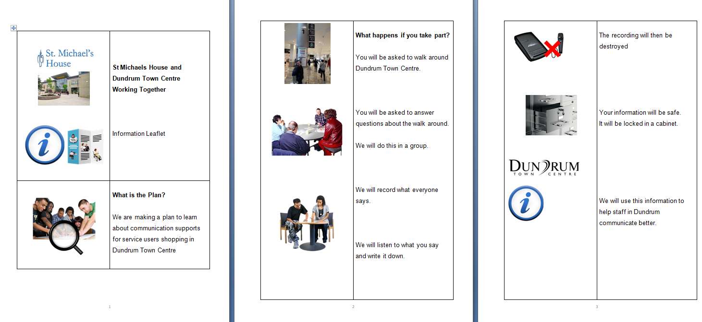
Participant Recruitment Supports
Created Easy read accessible information leaflet
Easy read consent from
Voice over presentation of the project
Researchers were not visible in the recruitment phase.

Slide 12
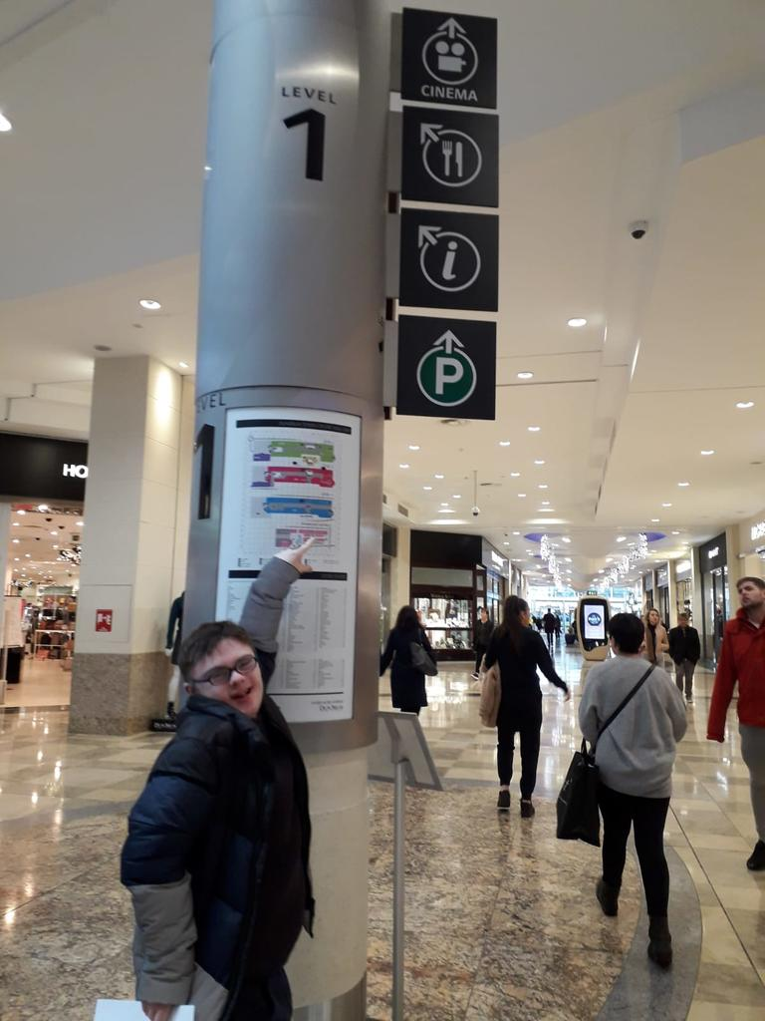

What happens if you take part?
You will be asked to walk around Dundrum Town Centre.

Slide 13

What happens if you do not want to take part?
It is OK. You do not have to take part.

Slide 14
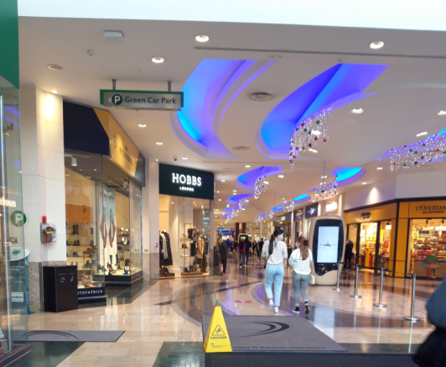
SMH Service User Walkround
7 participants
Briefing by SLT Dept
Completed Walkround of DTC with Easy Read guidance prompt sheet about communication in DTC
Notes:
Sasha Speaking Bring in the materials from walkround and the FG
In the following slide- the handout and the presentation – removed the pressure from somebody recruiting.

Slide 15
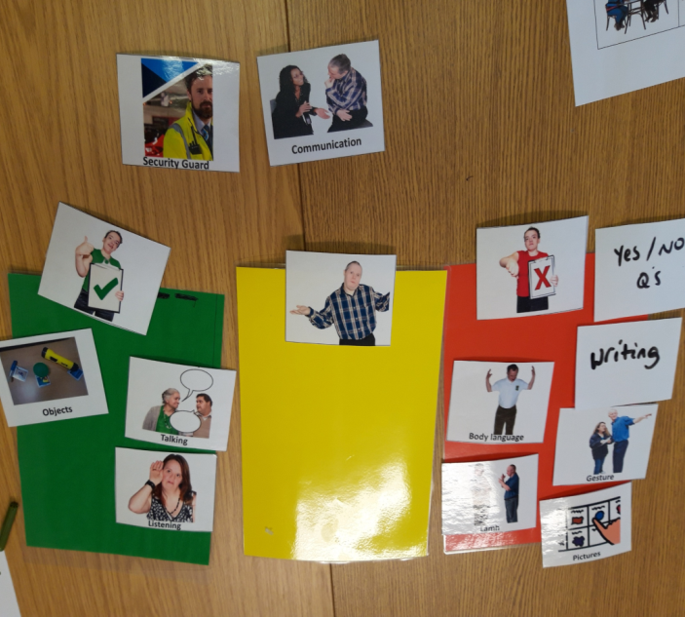
Service User Focus Group
Focus group facilitated by SLT dept
Share lived experience of communicating in DTC
Consultation group structure using Total Communication Approach, including Talking Mats
Data analysis findings from focus group incorporated into training package.
Notes:
Sasha speaking- Attended focus group following Walkround facilitated by SLT dept
Aim of the focus group was to share lived experience of what it is like to communicate in DTC
Consultation group structure using Total Communication Approach, including Talking Mats to support feedback from Walkround
Currently completing data analysis

Slide 16

Focus group data analysis findings
Overall, interactions with Dundrum staff were viewed positively by participants.
Evidence that a majority of participants both understood what was being communicated by staff and felt that staff could understand them.
Dundrum staff helped by:
  Listening to what participants were saying
  Giving participants sufficient time to ask questions/ respond
  Explaining things clearly to participants
  Speaking directly to the participants, rather than to their support staff
Notes:
Sasha speaking- Dundrum pictures?

Slide 17
Focus group data analysis findings
Participants identified several ways in which Dundrum staff could support their communication and make interactions easier:
  Speaking more clearly
  Using ‘yes or no questions’
  Using Lámh signs
  Body Language
  Giving participants time to ask questions

Slide 18
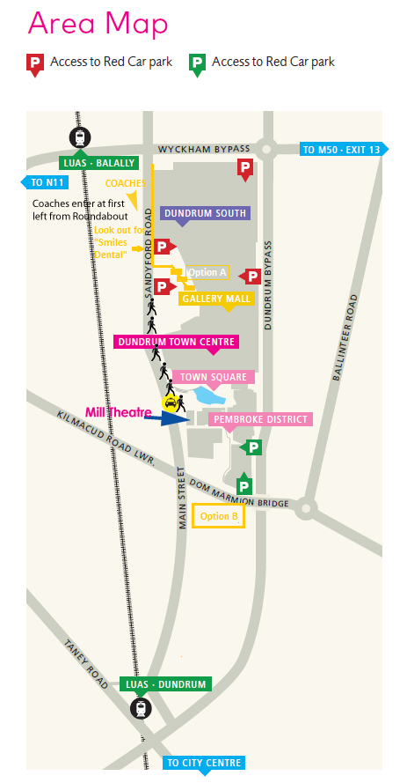
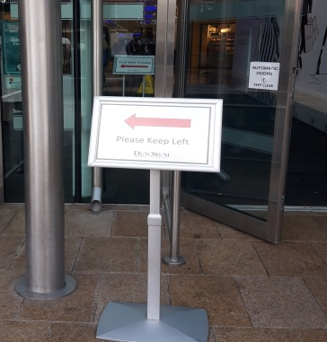
Data analysis Dundrum environment
Noise levels
Lighting
Signage
Maps
Notes:
Sasha

Slide 19
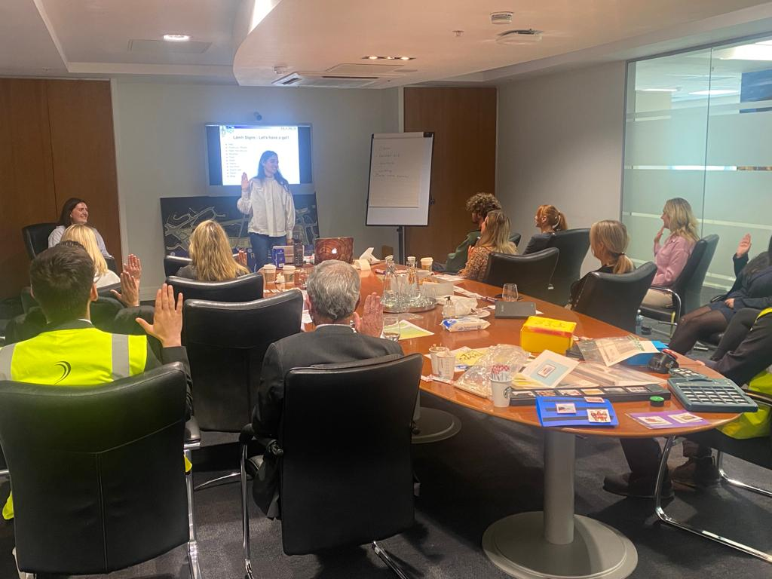
Training
First Training Date: 28th June 2022
Staff from management, security, information desk and a range of retail/hospitality teams attended
Training covered:
What is Communication
Communication and ID
The Total Communication Approach
The Person and different Communication Modes
The Communication Environment
Being a Communication Partner
Notes:
Jenny

Slide 20
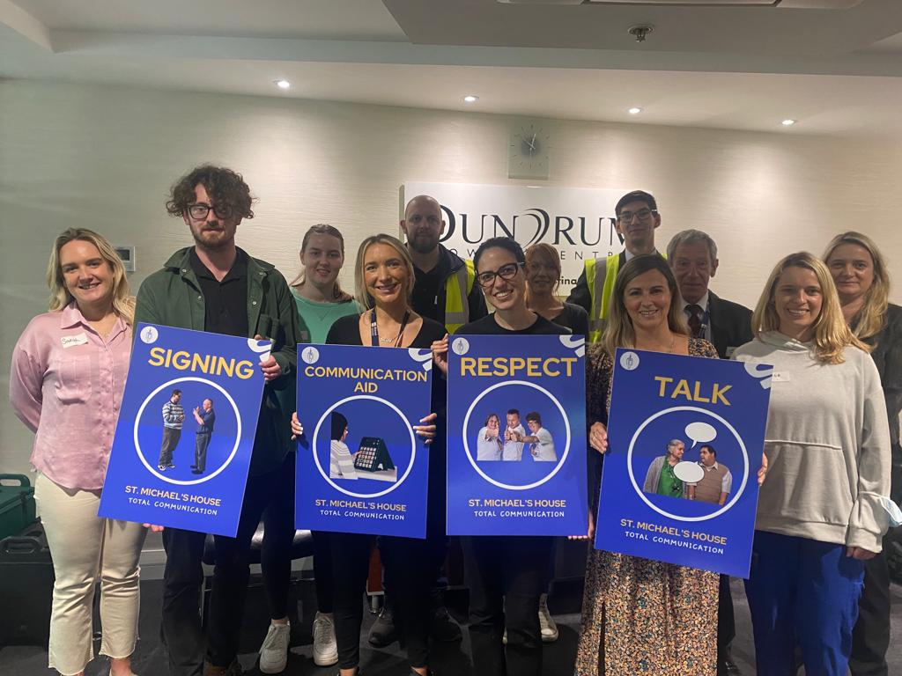
Training
Staff who complete the training are presented with a Badge indicating they are a DTC Total Communication Champion
Notes:
Jenny

Slide 21
What Next??
Total Communication training for staff in DTC completed
Second training schedule in 2023.
Total Communication Champions badge in development(consultation with service users).
Environmental supports have been explored with service user consultation and recommendations are being made
Research write up
Ongoing links with DTC as charity partner
SMH to continue to lead in future projects to further the develop natural supports for adults with ID in their locality
Notes:
Sasha speaking- Results from staff survey, family survey and service user focus group will be collated to inform a bespoke Total Communication training for staff in Dundrum
Initially 50 people to be trained by SLT Dept
Total Communication Champions, will then explore secondary training e.g. Lámh
Environmental supports will be explored Accessible signage and documentation etc. also with service user consultation
Plan to write up research to inform growing evidence base on social inclusion considerations for
Hope for SMH to be a leader in future projects to further the developing natural supports for adults with ID in their locality

Slide 22

Questions???

