Slide 1

3
Decision making
Third of three training sessions on the Assisted decision-making capacity act 2015
Notes:
Set up the projector with the PowerPoint.
Set up the room in circular or rectangular seating around tables.
Put up the flipchart with the decision making information gathered at the last session.
Distribute the materials as in the last session with each participant having a set of decision making paddles, a decision making chart, and an UNCRPD chart.

Slide 2

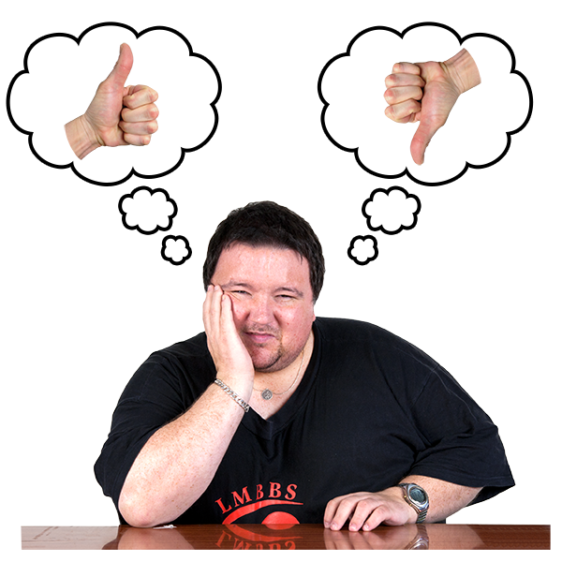
Decision making
Notes:
Begin with the flipchart from the last session on decisions.
Listen closely to what people remember from the previous session.
Circulate the decision cards and invite one or two people, if appropriate, to use the paddles to go through the steps of decision making. Move to next slide.

Slide 3

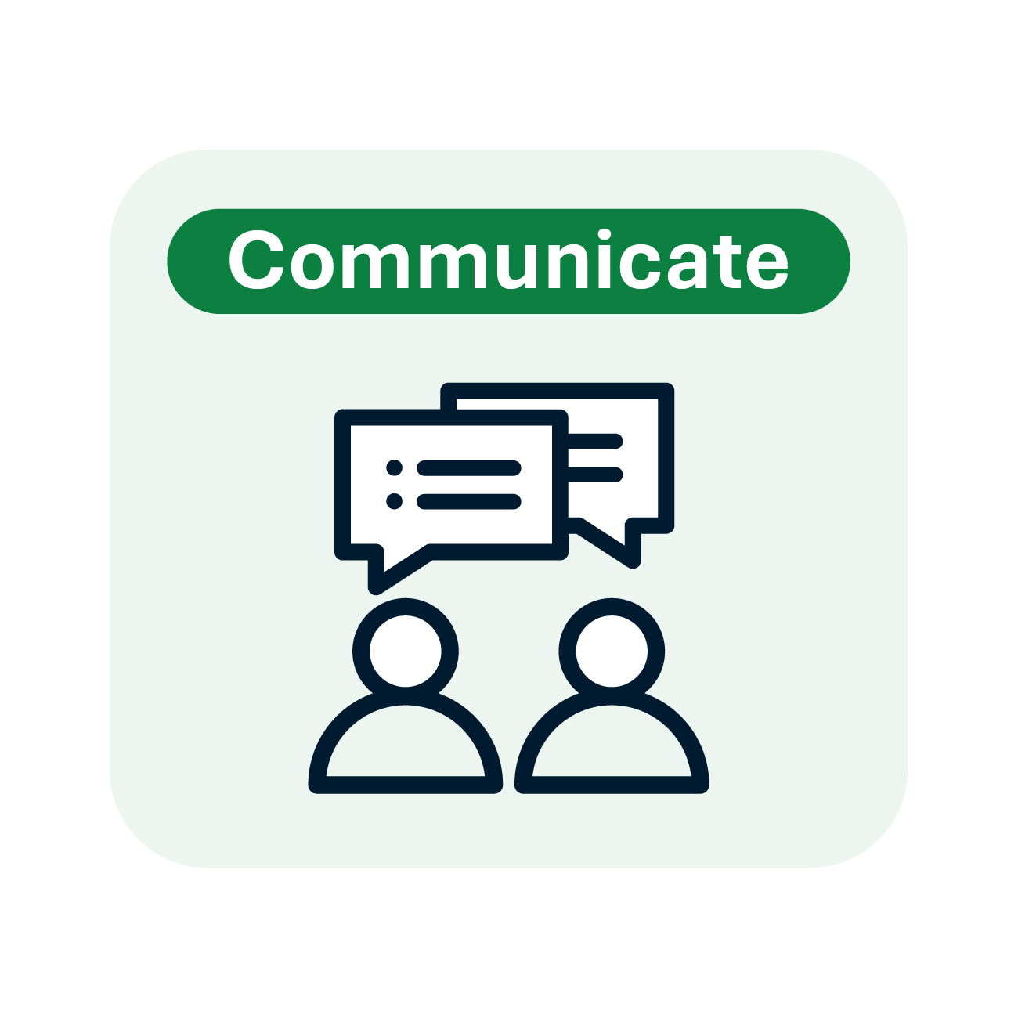
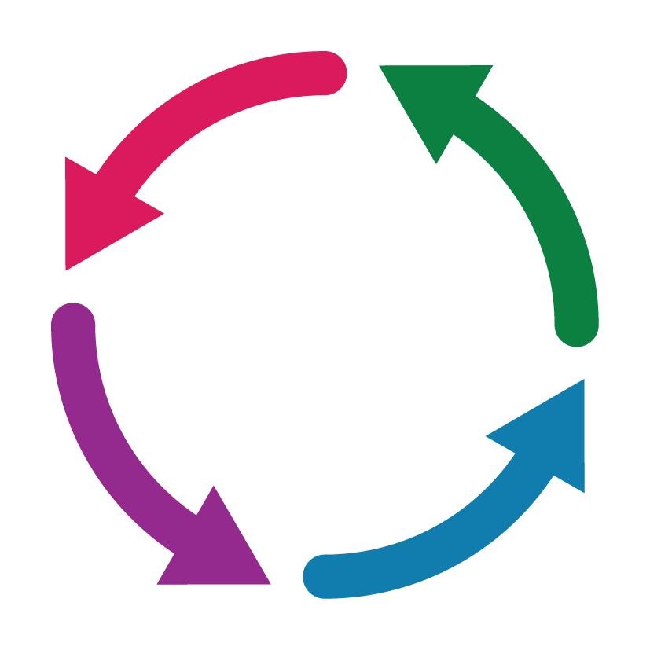


Decision making
Notes:
Template on decision making, pull together all of the aspects of decision making and explain the process of the arrows in a circular motion as describing a process.

Slide 4
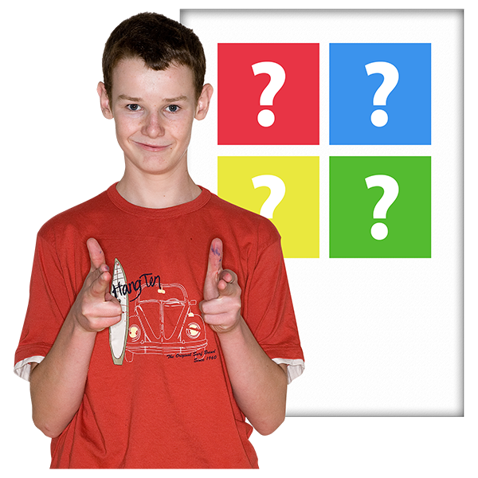
What decisions do you see in your future?
Notes:
Use the flipchart to record the decisions that people see themselves making in the future. Use this exercise to get a brief reading on the understanding people have of making decisions.

Slide 5
Paul, a decision support service champion
https://www.youtube.com/watch?v=MyTlwOSwVxw
Notes:
Let us listen to the story of Paul, a Decision Support Service Champion.

Slide 6

Decision Support Service (DSS),
Waterloo Road, Dublin
Notes:
As part of the Assisted Decision Making Law of 2015 a new service was created called the Decision Support Service or DSS. It is based in Dublin. When a person feels that they would like decision making support the first step is to apply to the Decision Support Service.

Slide 7
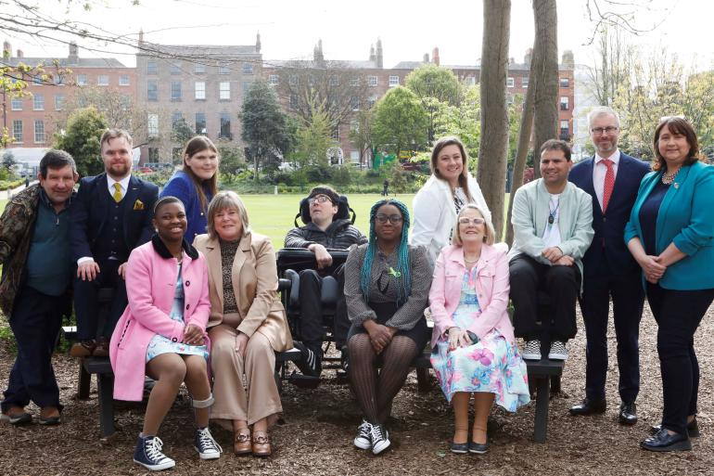
Decision Support Service
https://x.com/dss_ireland
Notes:
The Assisted Decision Making Act was signed into law in 2015. It replaced very old legislation called the Lunacy Act of 1871. This new law and the Decision Support Service are formed on the belief that the place to begin in decision making is that each person has the ability to make decisions or has capacity.

Slide 8
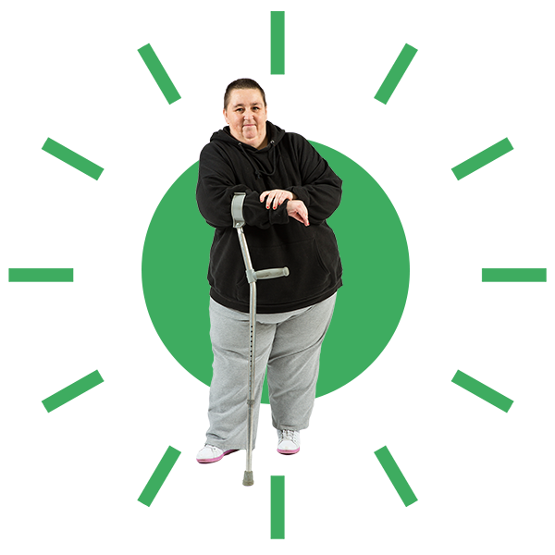

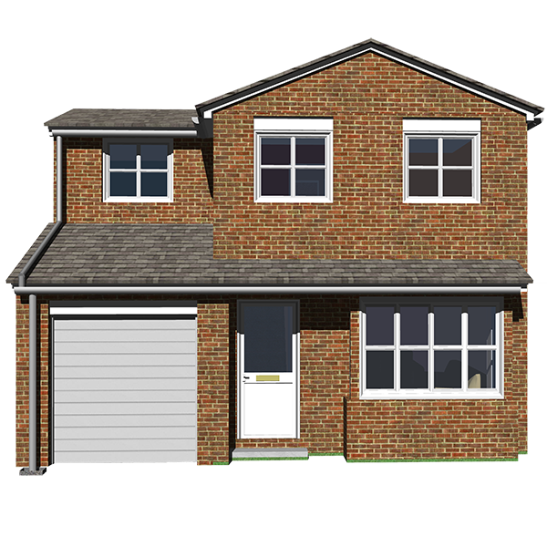
The decisions supported
Health or well being
Money
or banking
Housing
or property
Notes:
Some decisions are supported and some are not. The Decision Cards that we have been using are in these areas. (Use the flip chart to put the decision cards into the categories).

Slide 9
Health or well being
My housing
My role in who supports me
My healthcare
My social life
My use of social services
My day service
Notes:
Review the decisions around Health and Well Being.

Slide 10
Money or banking
My money
My bills
My taxes
My bank account
Notes:
Review the decisions around Money or Banking.

Slide 11
Housing or property
How I buy, sell, or rent a house
How the law is connected with my life
How I receive social benefits
How I am supported if I am part of a business
Notes:
Review the decisions around Housing or Property.

Slide 12
The Decision Support Service does not support some decisions.
These decisions are covered by other laws.
Notes:
The Decision Support Service does not support some decisions. Other laws cover these decisions.

Slide 13


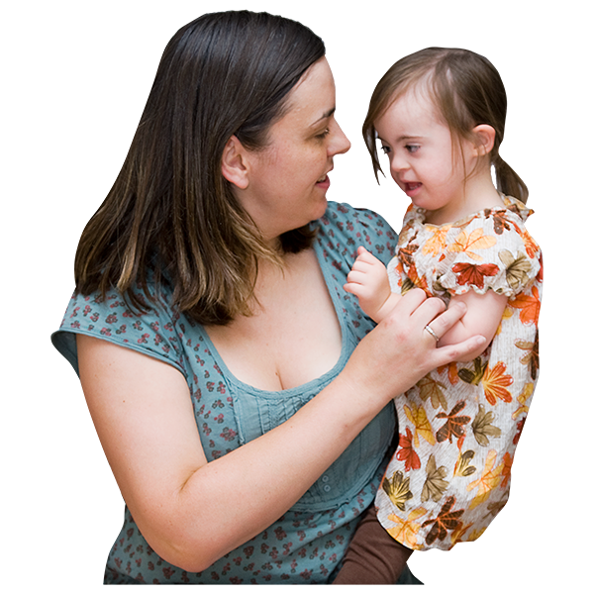
The decisions NOT supported
Making a will
Marriage, divorce, or separation
Adoption

Slide 14
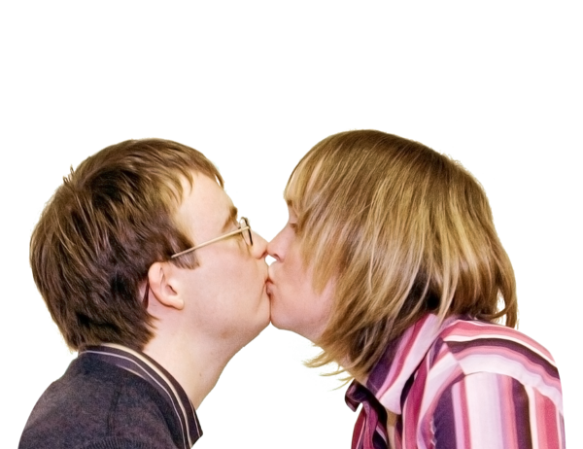
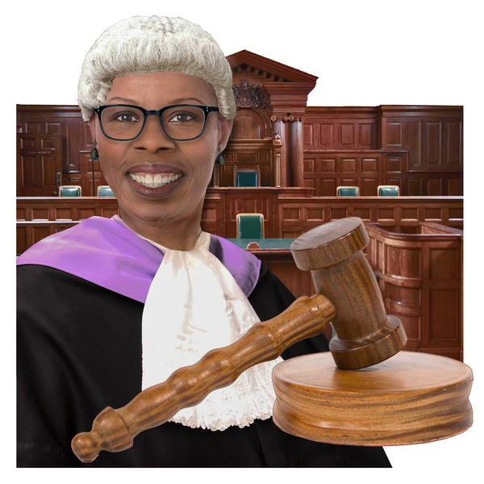
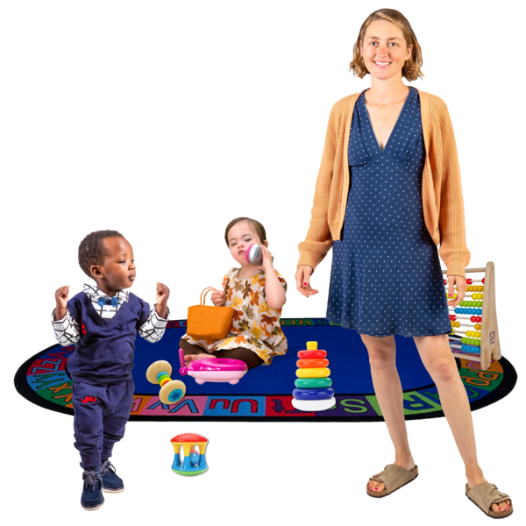
The decisions NOT covered
Sexual relationships
Being a member of a jury
Guardianship of children
Notes:
These decisions are covered by other laws.

Slide 15
Lydia, a decision support service champion
https://www.youtube.com/watch?v=92Qt3ziiGmY
Notes:
Let us listen to the story of Paul, a Decision Support Service Champion.

Slide 16
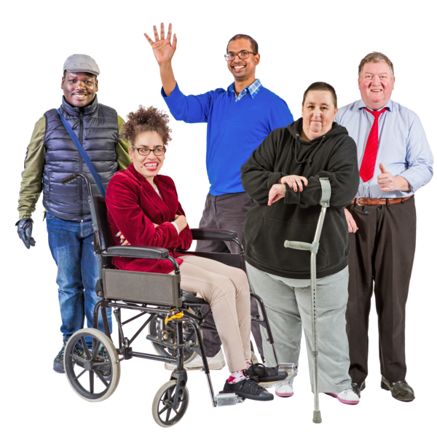
Decision supporters
Notes:
The next few slides review the roles in the Decision Support Service of people who may support others to make decisions.

Slide 17

Decision support arrangements
Depends on the support needed at the moment.
People who help are called decision supporters.
You may have a number of decision supporters.
Notes:
The role of the decision supporter is to work with you, the individual, to create what is called an “arrangement.” The arrangment is an agreement you have with one or more individuals to support you in making a decision.

Slide 18
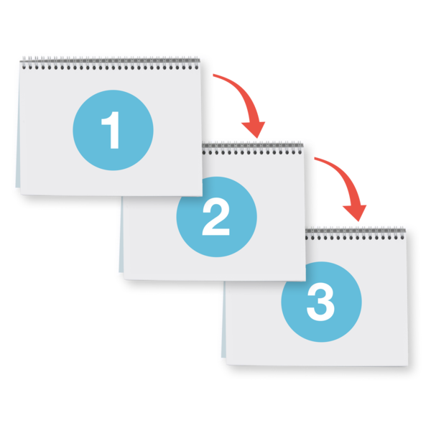
Three types of decision support arrangements
Decision making assistant
Co-decision maker
Decision making representative
Notes:
There are three decision Support Arrangements.

Slide 19
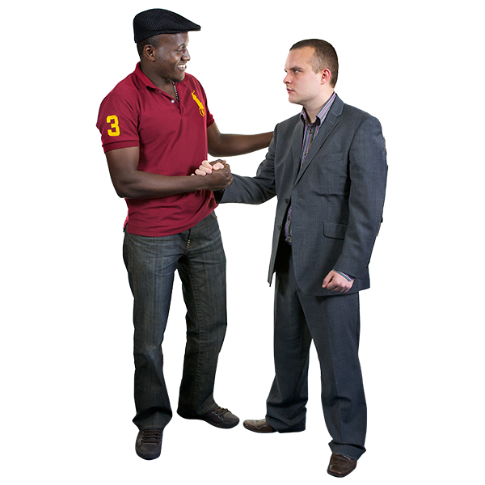
Decision-making assistant (DMA)
The role of the decision-making is to help you to make decisions for yourself.
Notes:
The first arrangement is called the Decision Making Assistant. The is the smallest or lowest form of support. The person that you select as a decision supporter is likely someone who knows you well. It may be someone in your family or a friend. This person cannot be a professional in a disability service. The person you choose helps you to make decisions for yourself. You may have one person that helps you with money decisions and another who helps you with health decisions. When this person or persons registers with the Decision Support Service they are listed on a register. If professionals are involved in a decision they may get in touch with the Decision Support Service to confirm that you have registered with the Decision Support Service.

Slide 20
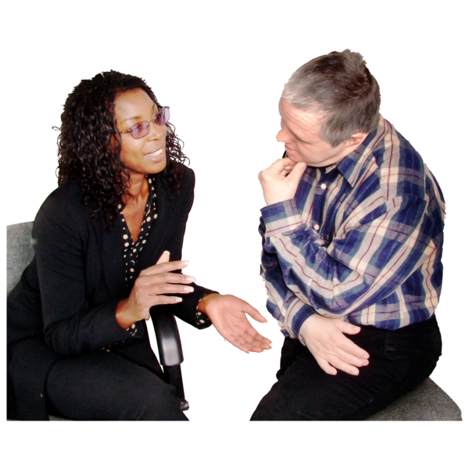
Co-decision maker (CDM)
The role of the co-decision-maker is to make certain decisions together with you.
Notes:
The next level of support is higher support than a Decision Making Assistant. It is a Co-Decision maker. This person, like with the Decision Making Assistant role is a person you select. You are involved in the selection of a person who knows you well. This person cannot be a professional in a disability service. The role of the co-decision maker is to make certain decisions together with you. This person provides more support to assist a person through the steps of decision making. This person will help to support a person as needed. This person will keep a record of how he or she supports the person in decision making.

Slide 21
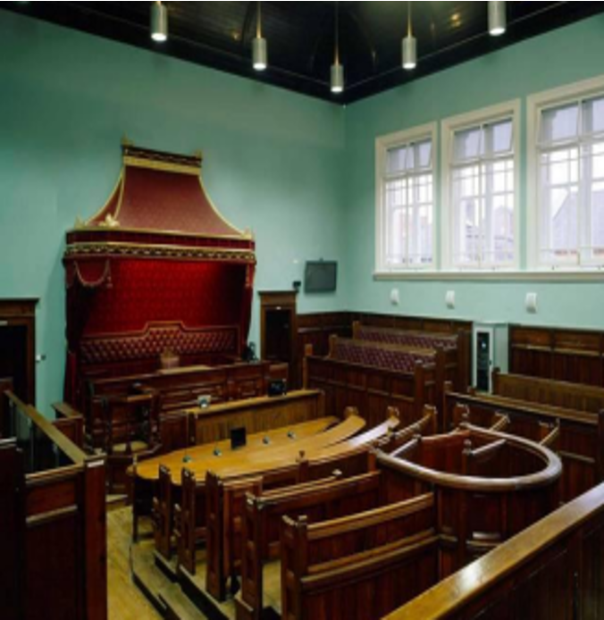
Decision-making representative (DMR)
The role of the decision-making representative is to make certain decisions on the person’s behalf.
The court will appoint someone the person knows and trusts. This will most often be a family member.
Notes:
The highest form of support is the Decision Making Representative. People who have the highest need of support, people who cannot take part in the steps of decision making, may apply for this support. This level of support involves an application to the Court. It will likely be a family member who applies to the Court. In the absence of a family member, the Court will appoint someone form a list of people kept at the Decision Support Service. This level of support replaces the Ward of Court in Ireland.

Slide 22
Florin, a decision support service champion
https://www.youtube.com/watch?v=5YZhv7E6XTM
Notes:
Let us listen to the story of Paul, a Decision Support Service Champion.

Slide 23
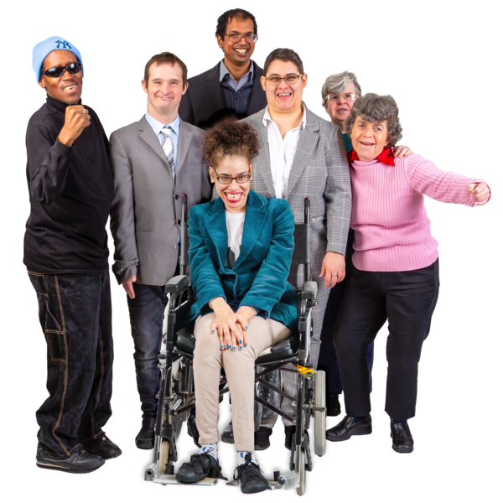
Decision Support Service - One Year on 2024
https://t.co/Kgnxmwu9Vv

Slide 24
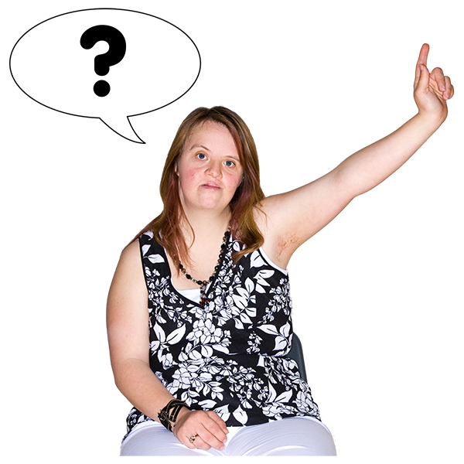
Questions

Slide 25
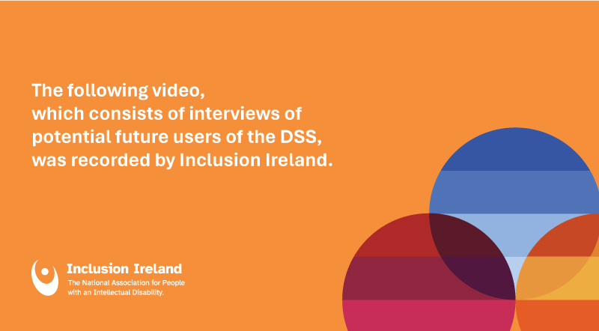
Support
DSS Collaboration: Inclusion Ireland Potential Service Users
https://www.youtube.com/watch?v=yCFDSLJeJL4
Notes:
Let us listen to the story of Paul, a Decision Support Service Champion.

Slide 26
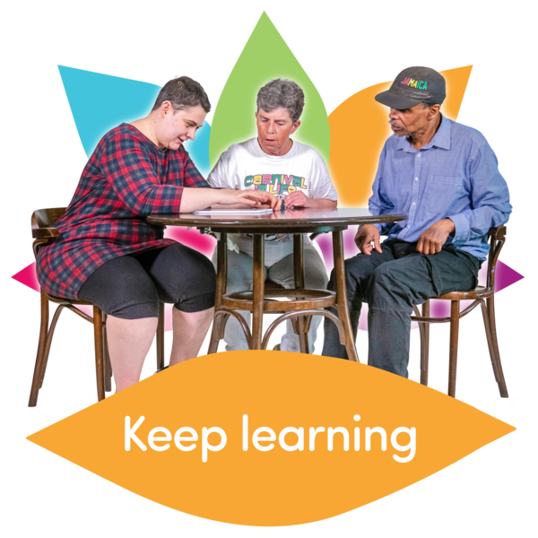
What did I learn today?
Notes:
Review the Decision Support Roles.

Slide 27

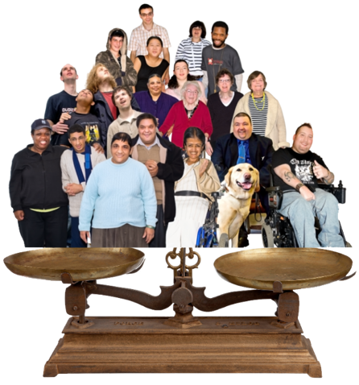
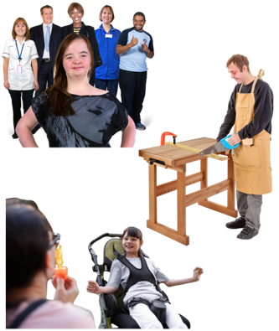
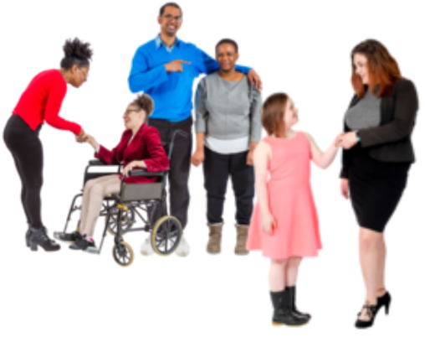
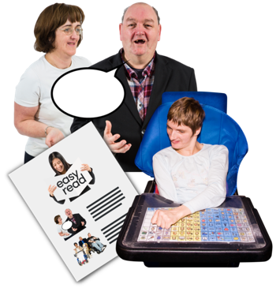
Our values
Respect
Inclusion
Equality
Voice
Choice

Slide 28



Our goals
Campaign
Support
Leaders
We are a campaigning organisation working for real change in people’s lives
We support people with intellectual disabilities to be valued and effectively participate in society
We are leaders in accessible information and communication

Slide 29







