Slide 1
1
Decision making
First of three training sessions on the Assisted decision-making capacity act 2015
Notes:
The emphasis of this first of three sessions is on an exploration of “decision making” and introduces the functional steps of decision making in easy to understand language.
Set up a flipchart with “choices” on one side of a page and “decisions” on the other side.
Have a template of the UN Convention at each place. Have the Paddles of Information, Remember, Think About and Communicate at hand. Have the decision cards at hand and use throughout the training to encourage conversation and interaction.
Begin with an icebreaker for the group to get to know one another.

Slide 2
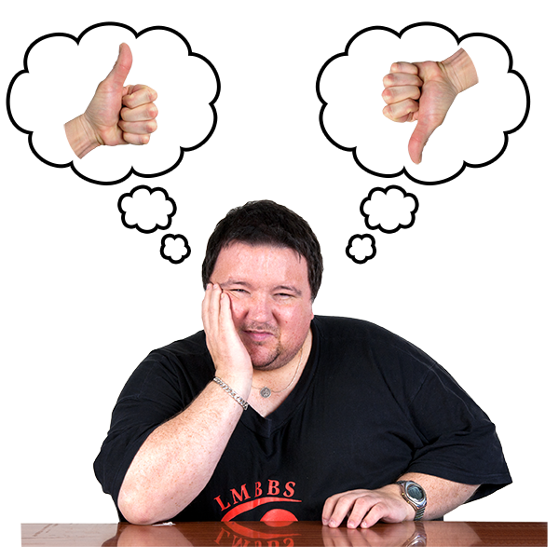
Decision making or making a choice
Notes:
Begin to explore how we use language around decision making. Begin with a conversation around the language. What is a decision? What is a choice? Let us begin with making a choice. It is when you have one or more things before you and the process then is to choose, or to make a choice.
For example, today I could have had toast or cereal for breakfast. My choice was toast. It did not take too much time and I went with my preference. A decision is when I have more to consider. As an adult I have to give time to and be informed to made a decision. Making a decision can make more of a difference in my life. For example, when leaving school I had to decide to what to do next. There were many paths for me to take. I had to look up information. I had to speak with others. I had to look at all of the possibilities. I had to decide what it meant to me if I chose one thing or another thing for my life.

Slide 3
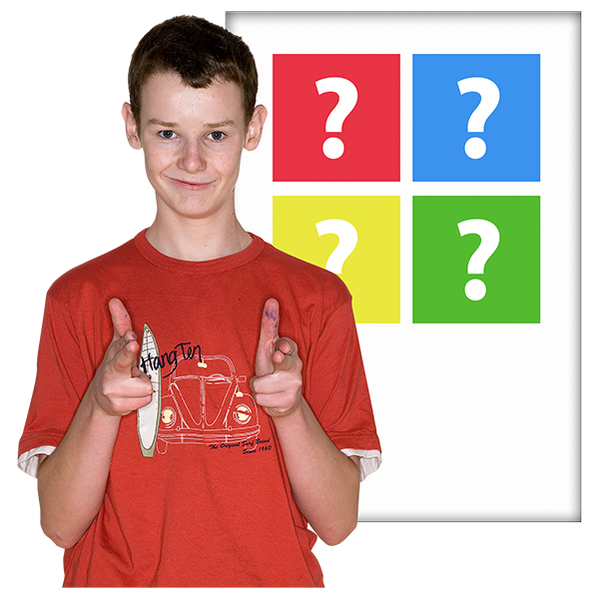
What decisions or choices did you make today?
Notes:
Let us look at some choices that you may have made today.
Use a flipchart to list any choices or decisions that people may make/may have made/ can make. Use the following slide to contribute to the discussion.

Slide 4
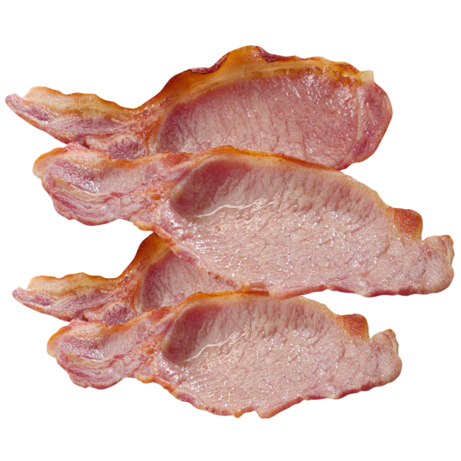
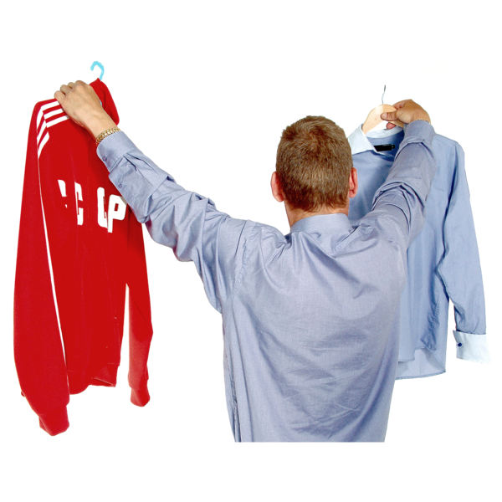
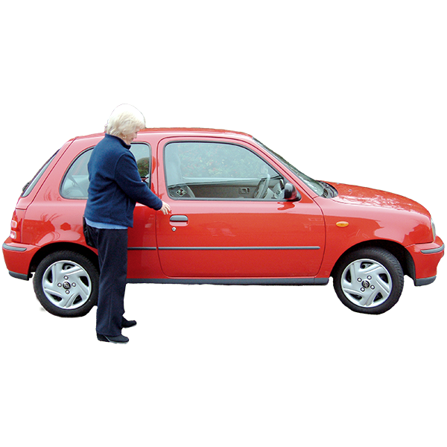
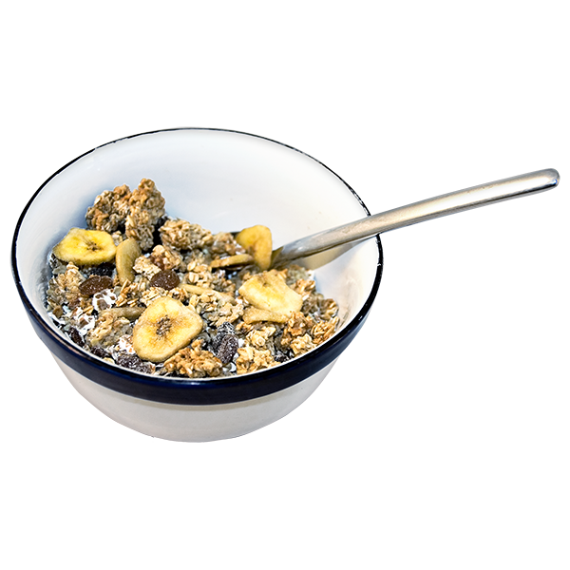
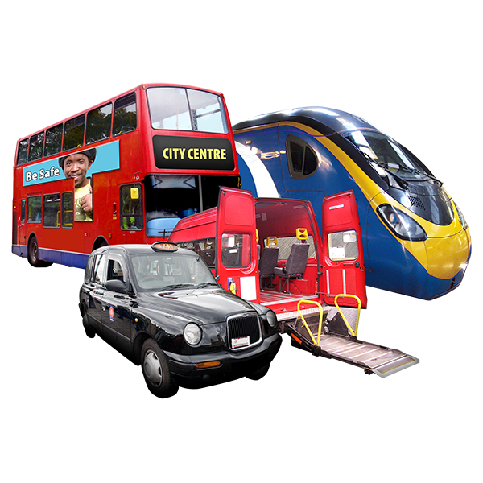
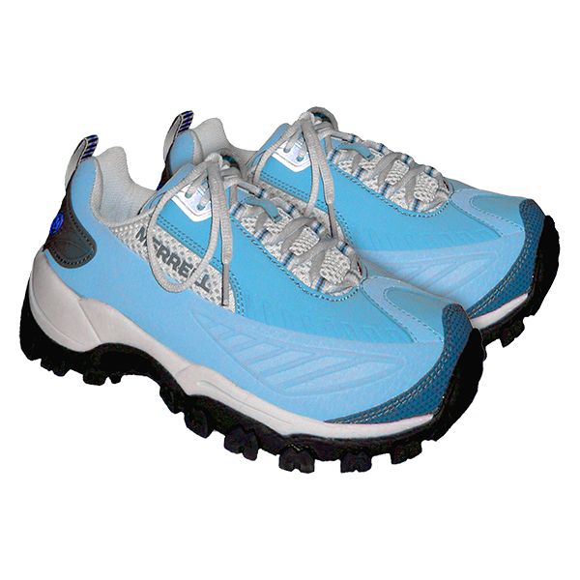
Time to get up
What to eat
What to wear
How to travel
Notes:
Invite four people to talk about choices they made this morning, one for each area. Invite each person to speak to their choices under each title. Explore the process of their choice in the words they use to give voice to the language of choice. Emphasise will and preference. Assess in the conversation if the people feel empowered (or not) to make their daily choices.
Engage participants in talking about their day. What choices/decisions did they make so far today? Emphasise the use of “choice” and the use of “decision” as we tell our story

Slide 5
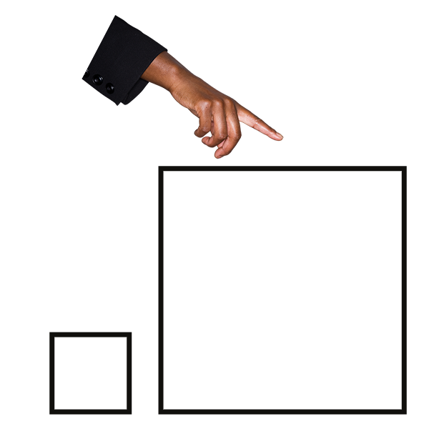
Decision / choice Small or big
Notes:
Use two different colour markers to circle on the flipchart to indicate if it is a small decision or a choice or a big decision.

Slide 6
Notes:
Which might you choose? Go slowly and get the participants to chat about their choice.
Is this a big or small choice/decision?

Slide 7
Notes:
Which might you choose? Go slowly and get the participants to chat about their choice.
Is this a big or small choice/decision?

Slide 8
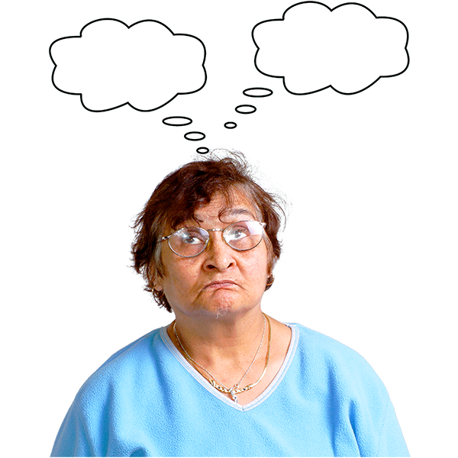
Making a decision
What are examples of decisions that you may make?
Notes:
Let us move from making a choice to making a decision. Is there a difference? In this section move from the understanding of a decision as needing more time/support.
Populate examples given on the flipchart.
One or two examples is fine. The list does not have to been exhaustive.

Slide 9
Notes:
What decision is being discussed in this photo?
What information might you want to know about deciding on a place to live?
Who might inform you?
Who might you talk to?

Slide 10
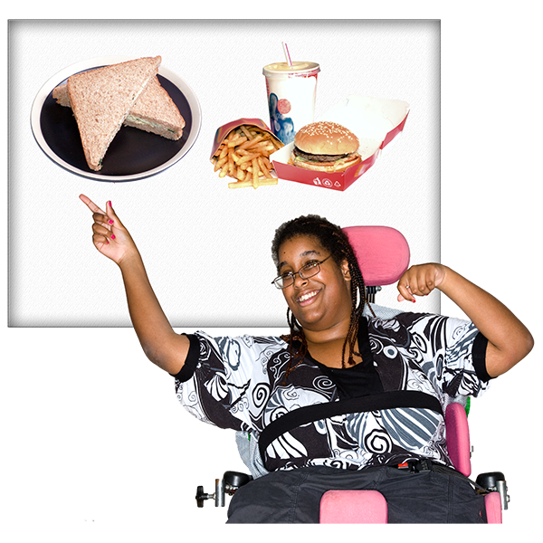
Notes:
What decision is being discussed in this photo?
What information might you want to know about deciding on a person to support you?
Who might inform you?
Who might you talk to?

Slide 11
Each of us have a right to make decisions
Notes:
The place to begin is with each individual. Each person has the right to make a decision. This is called having the capacity or the ability to make a decision. Other persons have to begin with this way of thinking. This is the law.

Slide 12
What might we have to think about in making a decision?
Notes:
Use the flip chart to record in the language of the participants what they find is necessary in making a decision, for example:
It takes more time
It can be difficult/hard
Other people get in my way
Who might we have in our lives to help?
What information may I need?

Slide 13
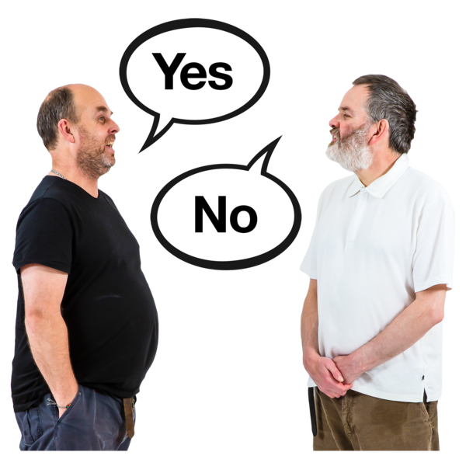
What makes it hard or difficult to make a decision?
Notes:
Use the flip chart for examples of decisions/choices. Discuss what makes it hard or difficult to make a decision: not enough information, pressure by friends/family/supporters, not enough time, not enough money, not having supports, difficulty understanding the outcomes or consequences of a decision, etc.

Slide 14
Decision making steps
(Functional capacity test)
Information
Remember
Talk about
Communicate
Notes:
Introduce the four paddles: each with a photo and a word on the four steps of the “functional capacity test”: Information, Talk About Remember Communicate
Introduce the concept of “functional capacity” as the language that may be used if there is reason for someone to wonder about a person’s ability to make a decision. A person in a professional role, such as a doctor, lawyer, or banker may mention the need for a functional capacity test. What this is is about the process of decision making. We will now explore the decision making steps.

Slide 15
Information
In a way that you can understand
In a way that you can explore the question
Notes:
Where do you go for information? What helps? Who helps? Do you like information in writing? Do you like information written down for you or recorded? How do you keep or store information?

Slide 16
Remember
What helps you to remember?
Notes:
To make a decision it is important that you remember the information about the decision, that you have some understanding of the parts of the decision. You may remember by recording information on a phone, writing information down, putting information into story form or picture form. Finding out what works to help you to remember is very important.

Slide 17
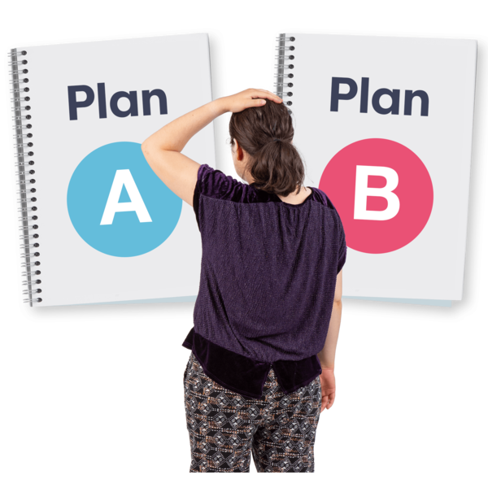
Think about
Look at all parts of the decision
Notes:
This step may take time. It is important to think about all the parts of the decision. In thinking about the decision you think about how a decision may make a difference in your life and in the lives of people around you. Sometimes this is called “weighing up” a decision by looking at all of the parts.

Slide 18
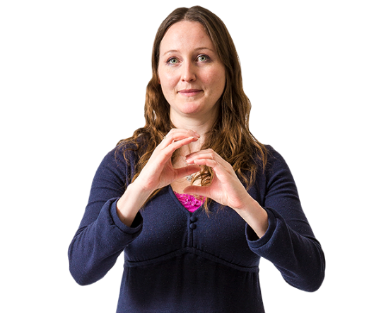
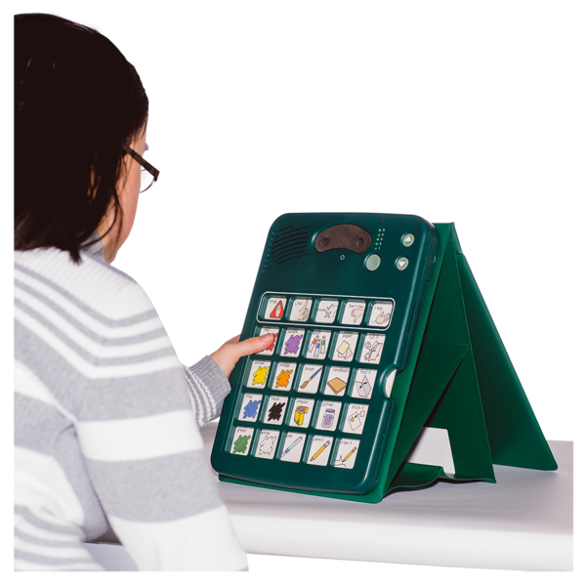
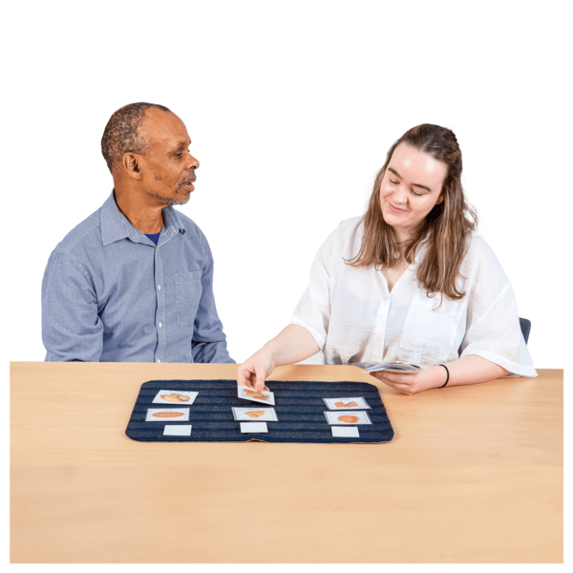
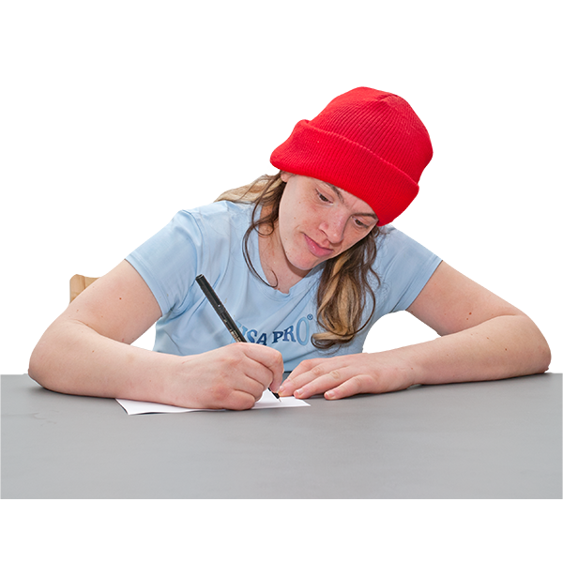
Communicate
Share your decision
Using words, drawing, audio, video, tablets, cards, body language, or other ways
Notes:
To share your decision or to communicate or talk with someone is an important part of decision making. There are many ways to share a decision by the sharing of words, drawing, audo, video, tablets, cards, body language, or other ways.

Slide 19
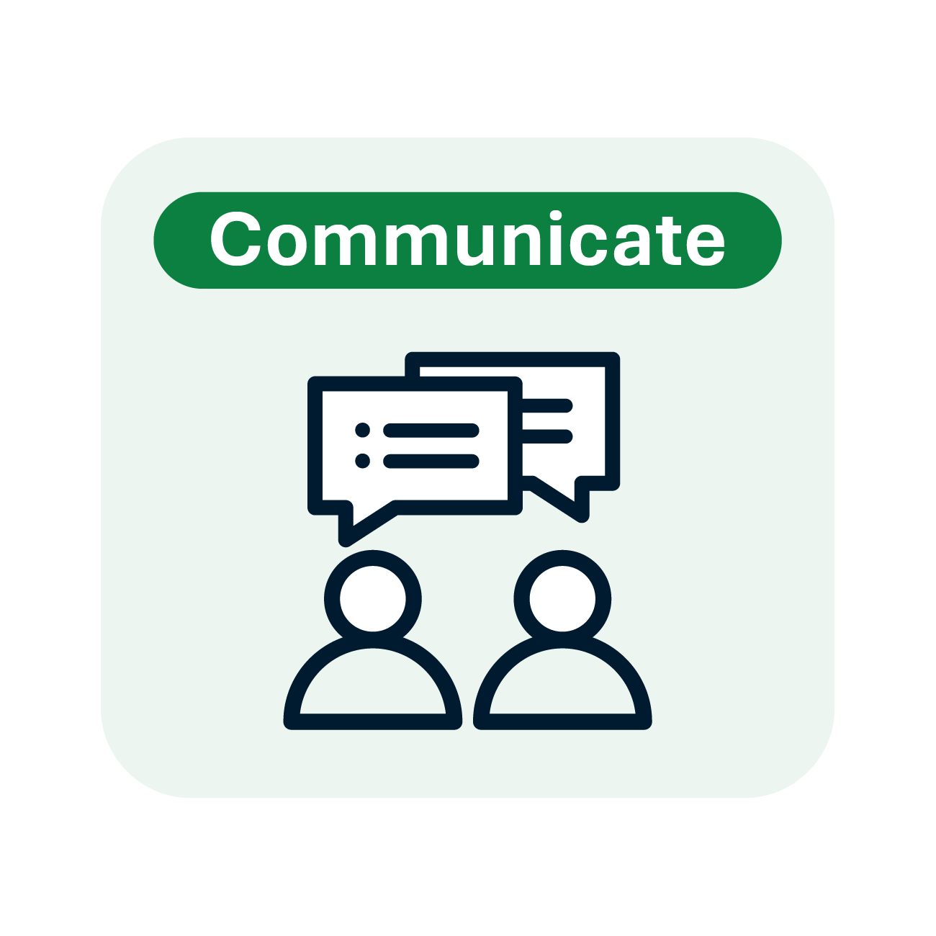
Decision making
Notes:
Template on decision making, pull together all of the aspects of decision making and explain the process of the arrows in a circular motion as describing a process.

Slide 20
In Ireland the right to have support to make decisions is written down in the Assisted Decision Making Act of 2015. Other names for this law are: * ADM 2015 * Act 2015 * Capacity Act
Notes:
This law is to protect you and to protect the people who support you. It is the Assisted Decision Making Act of 2015. The law goes by other names such as the ADM 2015, the Act of 2015, or the Capacity Act. It replaces the old law which was called the Lunacy Act from 1871. It is a law that respects the will and preference of the individual. It creates levels of support that respect that each person has the right to make decisions.

Slide 21
In the Assisted Decision Making Law there is a new service to help people. It is called the Decision Support Service. This service opened in April 2023.
Notes:
If you have a big decision to make and would like support or if others have concern over your ability to make decisions you may get support through registering or signing up with the Decision Support Service. This will only be if there is question about your ability to make a decision.

Slide 22
People in your life will continue to support you as they support you now. You may or may not have need of this service. We will learn more about this service in the next sessions.
Notes:
People in your life, your family members, friends, supporters will continue to support you as you may need. This will not change from the support that you have now.
If you need more help there is a law that can help you.

Slide 23
Questions

Slide 24
What did I learn today?
Notes:
Look back at the flip chart, look back on slides, and use the paddles for a quick review.

Slide 25
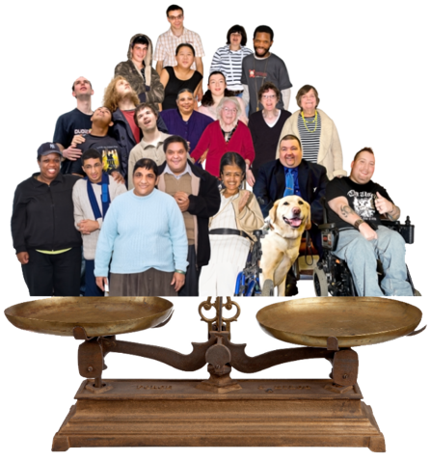
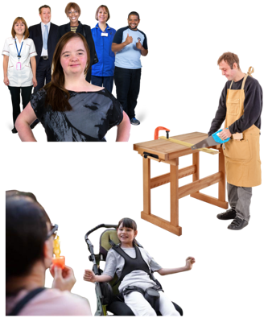
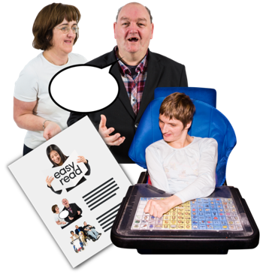
Our values
Respect
Inclusion
Equality
Voice
Choice

Slide 26
Our goals
Campaign
Support
Leaders
We are a campaigning organisation working for real change in people’s lives
We support people with intellectual disabilities to be valued and effectively participate in society
We are leaders in accessible information and communication

