Slide 1
An Enquiry into the Use of a Digital Hub as a Pathway to Social Inclusion for People with Intellectual Disabilities
Presentation by
Sarah Hewitt &
Nicole Redmond
St. Michael's House, 2023

Slide 2
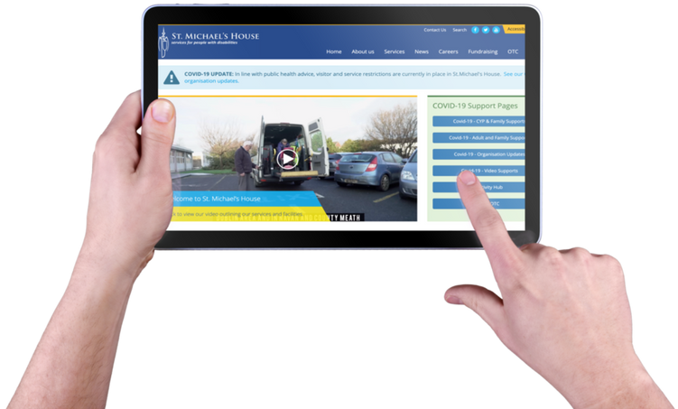
BACKGROUND
The Digital Hub was established in response to the Covid-19 pandemic with the aim of enhancing service provision.
It allows adults to connect online and access a range of information through our website

Slide 3
RESEARCH PROBLEM
In today’s connected world, digital inclusion can be perceived as a fundamental aspect of social inclusion (Reisdorf & Rhinesmith, 2020), yet people with ID continue to experience lower levels of digital participation (Chadwick et al., 2022)
Few people with ID are involved in the design of digital technologies (Chadwick & Fullwood, 2018)
People with ID are often not included in research (Jen-Yi et al., 2015; Salmon et al., 2018)

Slide 4
LITERATURE REVIEW
SOCIAL INCLUSION
DIGITAL INCLUSION
INCLUSION IN RESEARCH

Slide 5
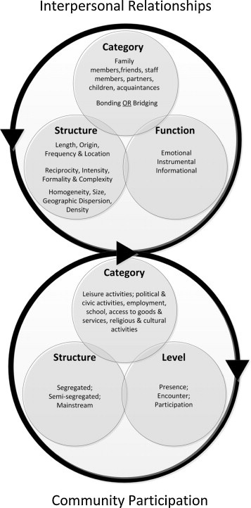
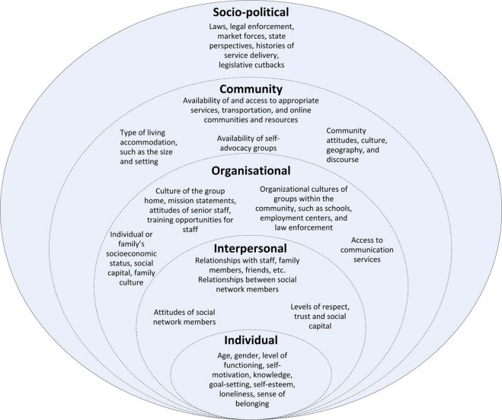
CONCEPT OF SOCIAL INCLUSION
Model of Social Inclusion
Ecological Pathways to and from Social Inclusion
(Simplican et al., 2015)

Slide 6
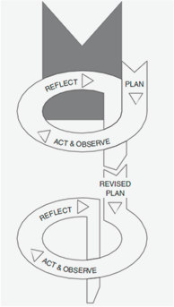
METHODOLOGY
PARTICIPATORY ACTION RESEARCH
Kemmis and McTaggart, 2000)

Slide 7
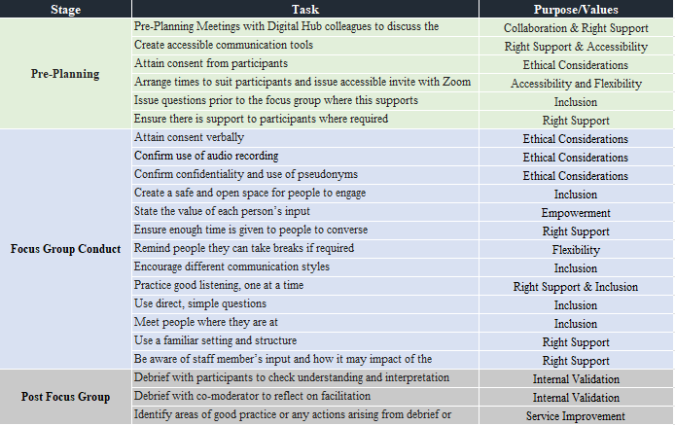
CONSIDERATIONS FOR INCLUDING PEOPLE WITH DIVERSE NEEDS IN RESEARCH
Ethical Considerations
Academic systems
Tokenistic Participation
Abstract topics
Inaccessible Information
Power Dynamics
Resources
Meaningful Contribution
Models of Support

Slide 8
DATA COLLECTION
Reflective
Journals
Document
Analysis
Focus
Groups
Co-Creation
Workshop
Staff
Correspondance

Slide 9
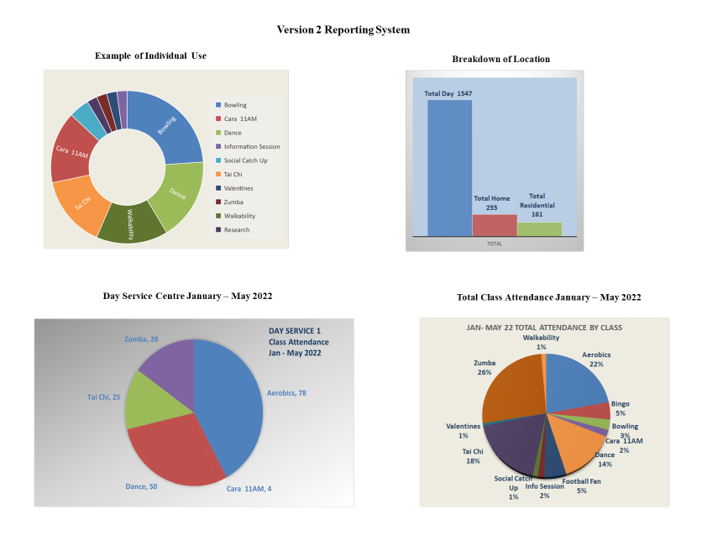
CYCLE 1

Slide 10
CYCLE 2
FOCUS GROUPS
CO-CREATION WORKSHOP
Seed Funding:
Transcription Services
Seed Funding:
Illustrator

Slide 11
PARTICIPATION

Slide 12
MAIN THEMES
DIGITAL PATHWAYS TO SOCIAL INCLUSION
DIGITAL INCLUSION
Access
Skills &
Confidence
Right Support
Motivation
Community Participation
Interpersonal Relationships

Slide 13
DIGITAL INCLUSION
Audrey was saying she has her own tablet and she likes to work on her own tablet and she sometimes sends emails or gets them (FG 2, Staff Advocate)
I’d like to do software stuff, typing. Yeah letters and stuff. Or stories. Typing up stories and letters, do you do some of that already? Yeah but I’d like to do it more, kind of on the stuff that we do.
I forget passwords, I forget how to get it. Numbers I forget.
If there was no zoom or none of these technologies we wouldn’t be able to meet people and things like that. If you look back to when we were all growing up, we didn’t have all this and look now what we have.
they’re well laid out (Cooking Recipes) with step by step and picture form...Some people mightn’t be able to read the measurements and things, they can look at the pictures and it shows what ingredients and the equipment to get out, things like that yeah.
Sometimes I use it at home and sometimes I use it in (day service), but when I never used the hub before, I needed staff to help me to log in to the activity hub.

Slide 14
PATHWAYS TO SOCIAL INCLUSION
If there was no zoom or none of these technologies we wouldn’t be able to meet people and things like that. If you look back to when we were all growing up, we didn’t have all this and look now what we have
I know the big one we did was the strategy where we never had done that before. So that was interesting to do. Where we did it on a Tuesday where we came into a big group and we divided into different groups and we had different topics to talk about each week
Yeah because the way Ruth (another Hub user) binded her burgers, it was good as well, you know....The way she had it all set up, like and stuff, like her ingredients ready and things like that, her mince and showed us how to do it and she had her apron on and everything...she was very good on its, she was
like activity hub made me better day, because it's like a community
I was going to say to you I’d love to be on the committee for the activity hub next year. I’d love to be the person to make a plan. And write down the ideas
I thought it was good because each person had a job to do. In the Halloween one we all had a job to do. I was doing the judging of the costumes and then Emma had a job picking out the best pumpkins. And somebody else, Ciara had where she was doing the quiz and then Ruth was the welcoming speech and that and then Noah was doing his Lamh
They were good....Made us feel great that we can get involved in doing things like that
what if we do a focus group, with all other groups. About how to get involved in research, find information, put it all together
I like it where it’s at the beginning of the week (Tai Chi) and it relaxes you for the week, gets you ready for the week, gets you motivated for the week. And you’re more calmer then for the week. We need to do that because sometimes you can get all hyper and its nice and relaxing

Slide 15
NICOLE REDMOND
How I got involved in the research project
How I felt about taking part in the research
What we learned
How we improved the Activity Hub

Slide 16
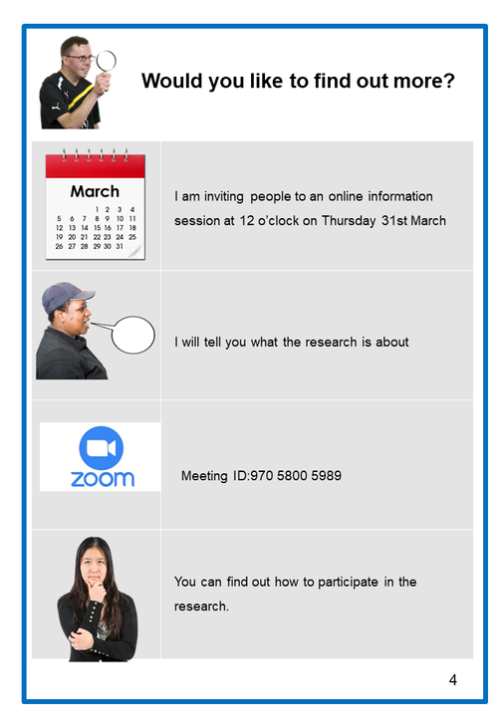
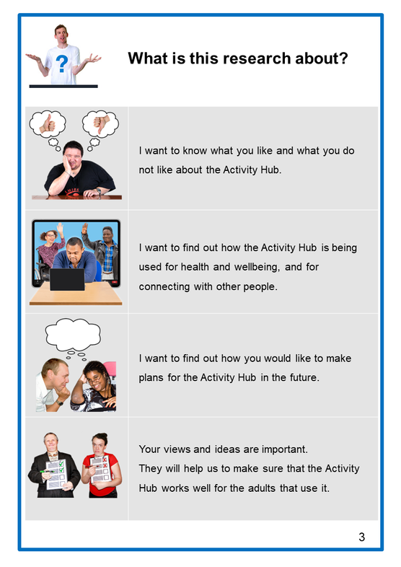
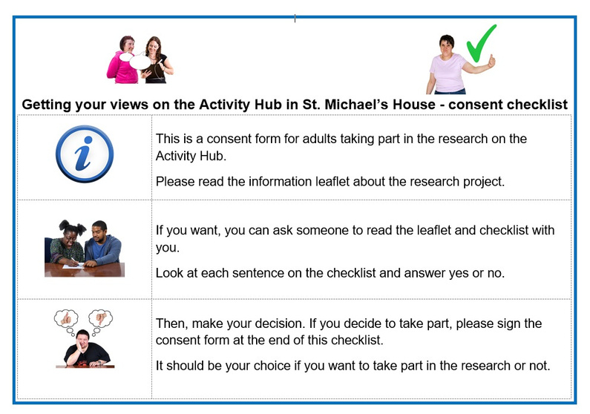
MY EXPERIENCE IN RESEARCH
How I got involved in the research project
Information session
Information Booklet
Consent

Slide 17
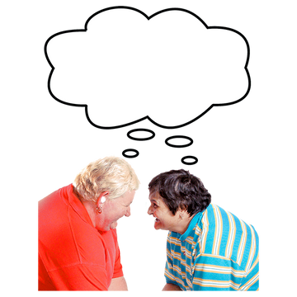
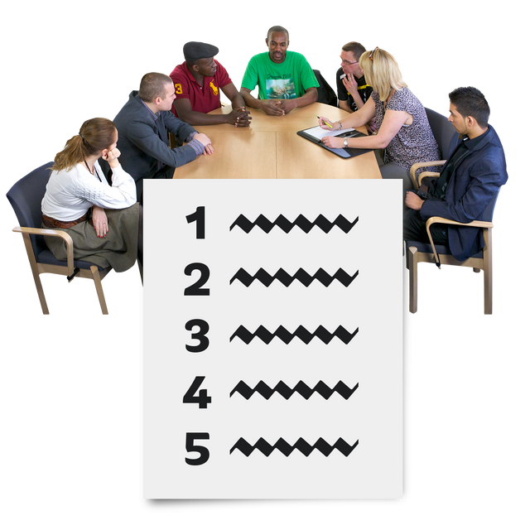
MY EXPERIENCE IN RESEARCH
How I felt about taking part in research
We heard other people's views
We worked in a group and gave our ideas
It is important for
SMH to hear from us
We helped to make a plan for the Activity Hub

Slide 18
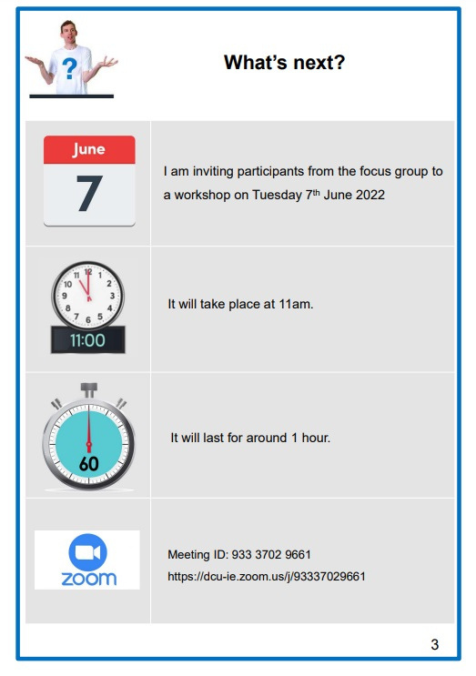
CO-CREATION WORKSHOP

Slide 19
WHAT WE LEARNED

Slide 20
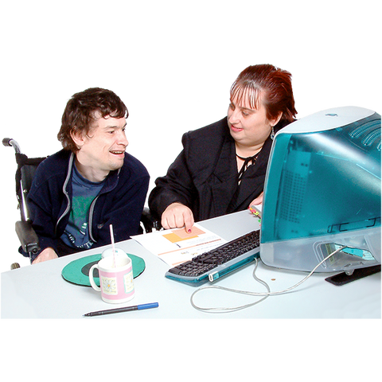
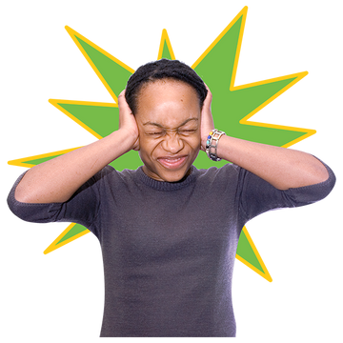
CHALLENGES USING THE HUB
Having a device
Wifi
Having support
Too much noise

Slide 21
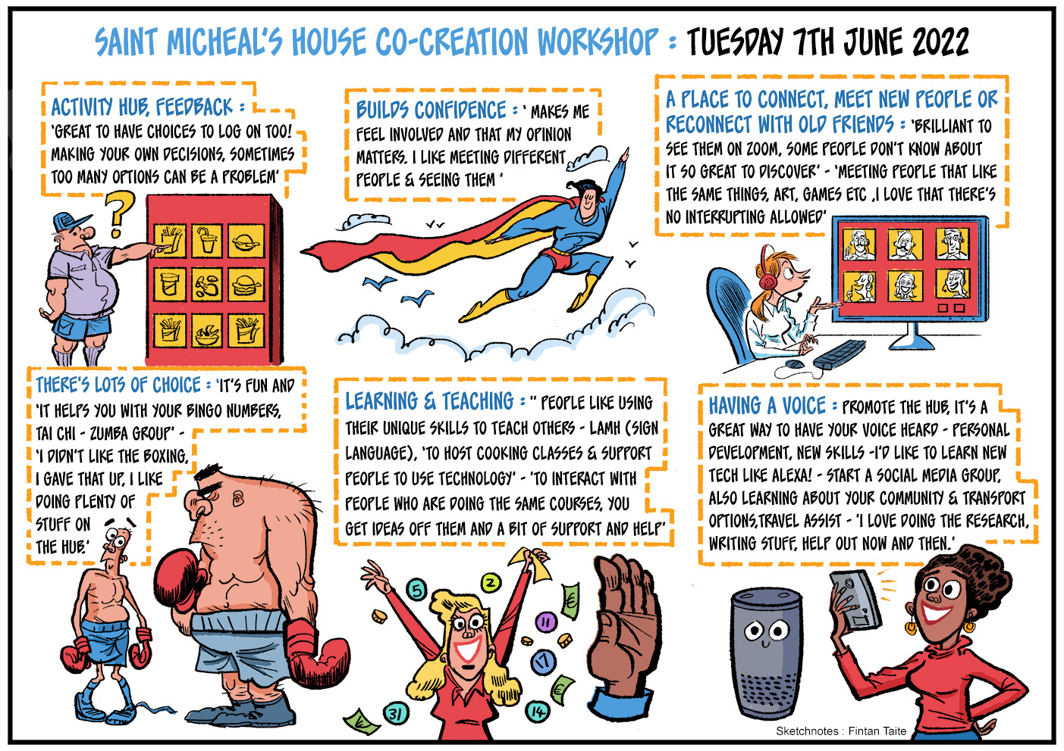

Slide 22
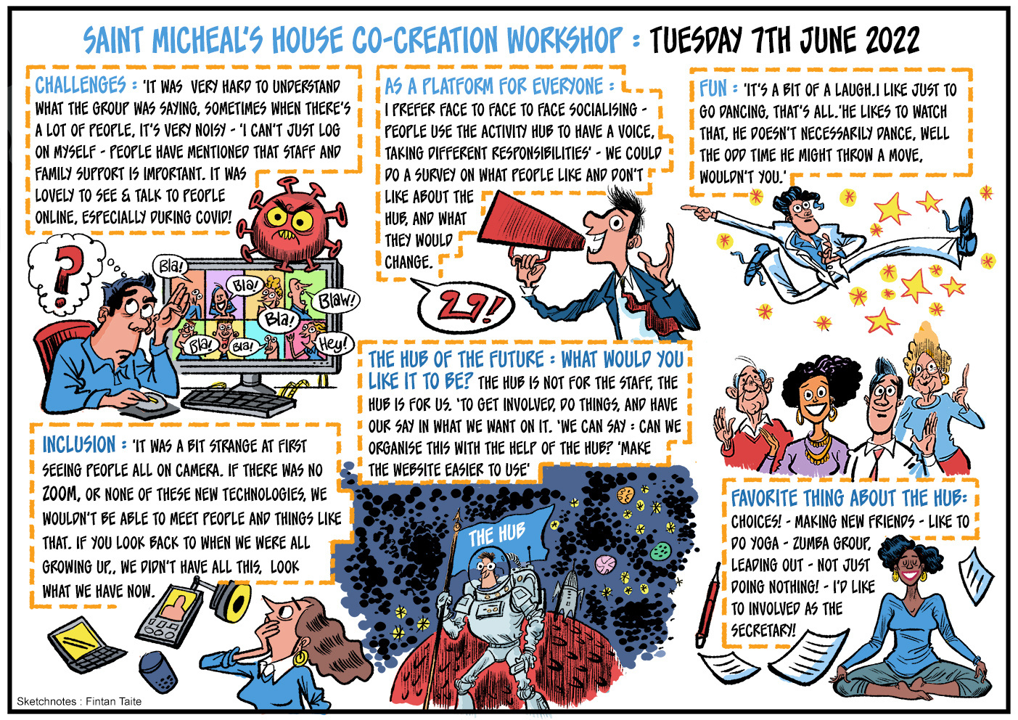

Slide 23
IT'S OUR HUB!!
“And people think oh why is she organising this, it should be the staff in the hub, as we said the hub is not for the staff, the hub is for us, for us to get involved and do things. They’re just there to set up the hub and be hosts and let us in and things. But in the end, it's for us and we can have our say in what we want on it. And we can say can we organise this, with the help of the hub.”

Slide 24
RECOMMENDATIONS
Host a Research Workshop for peer-to-peer learning
Use Action Research model as an approach to development
Recruit Multidisciplinary advisory panel to help with development
Set up formal service user-led advisory panels
Co-create a new accessible website with adults from SMH

Slide 25
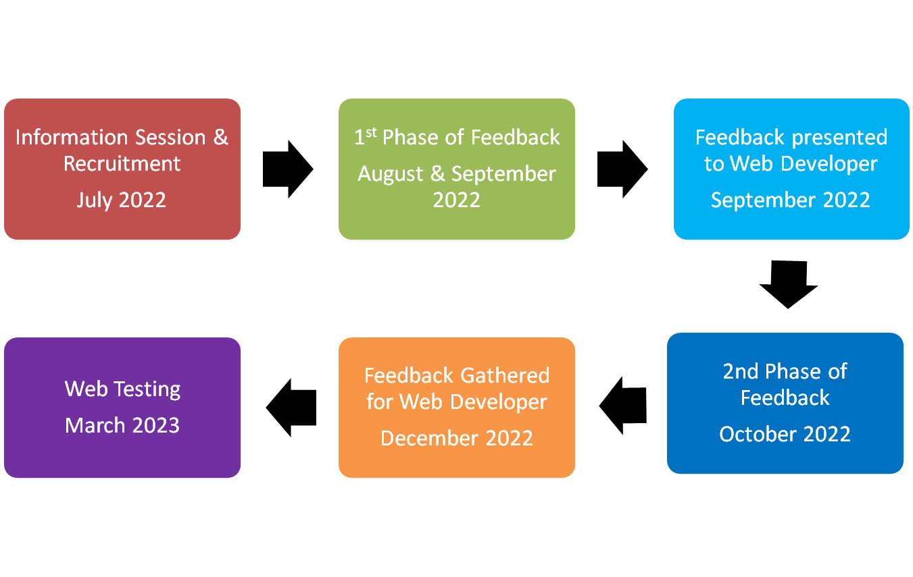
WEBSITE DEVELOPMENT

Slide 26
From this

Slide 27
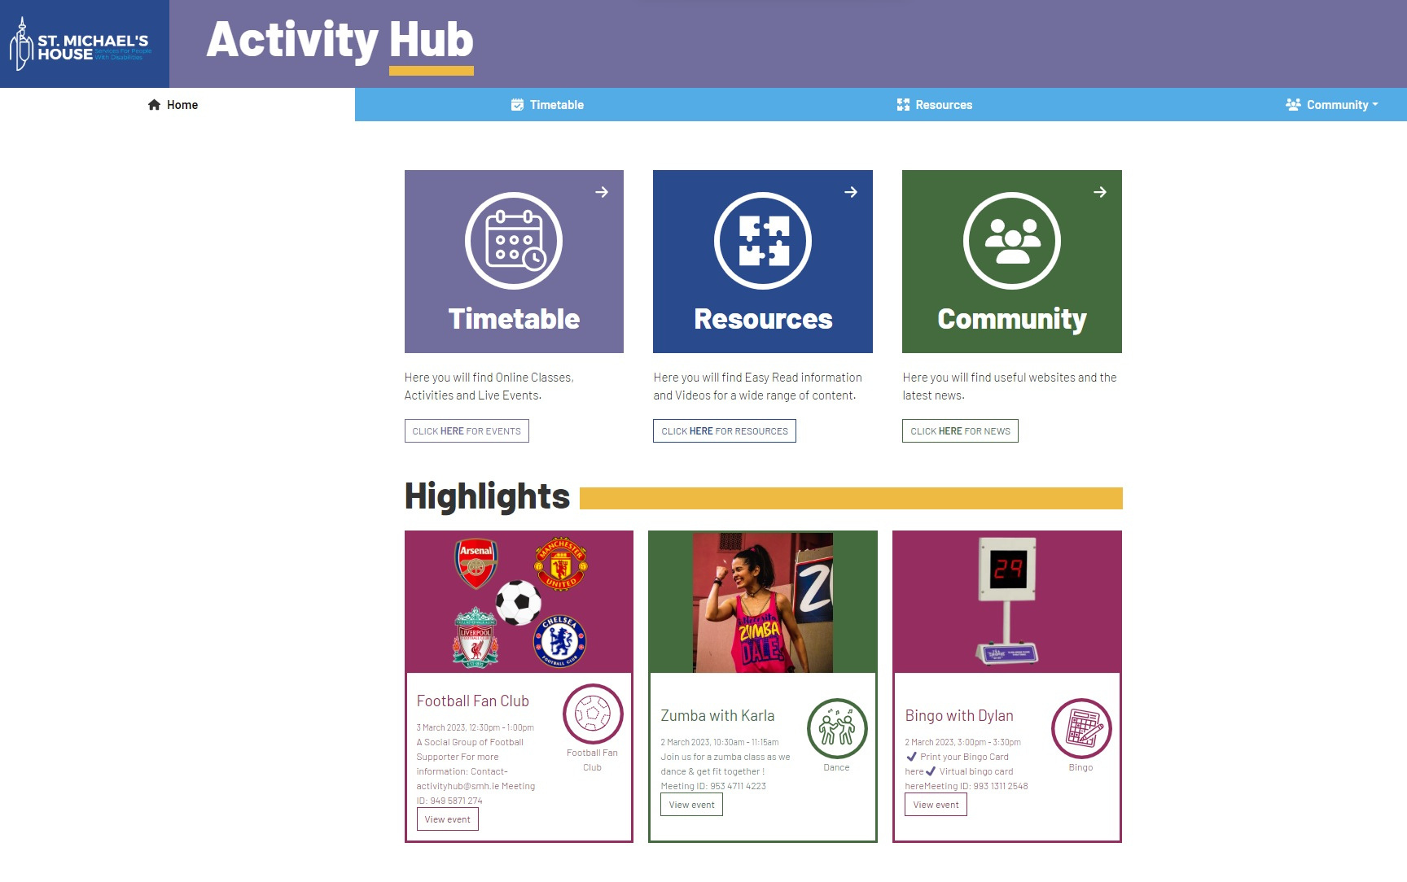
To this

Slide 28
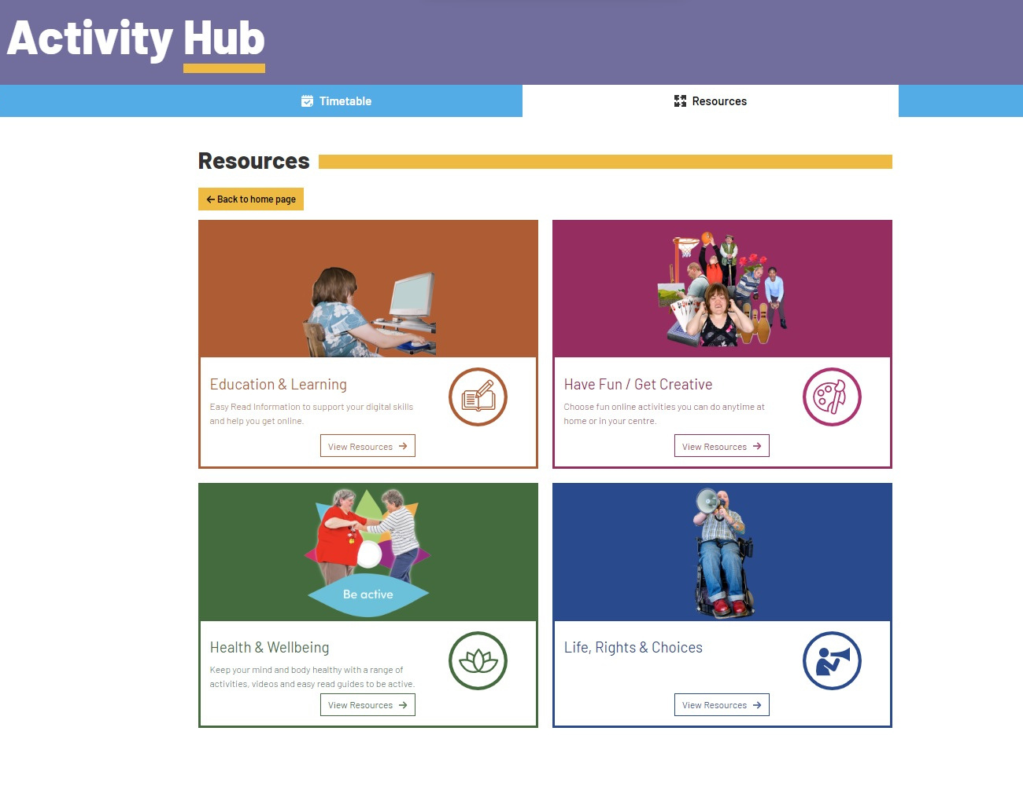
And this

Slide 29
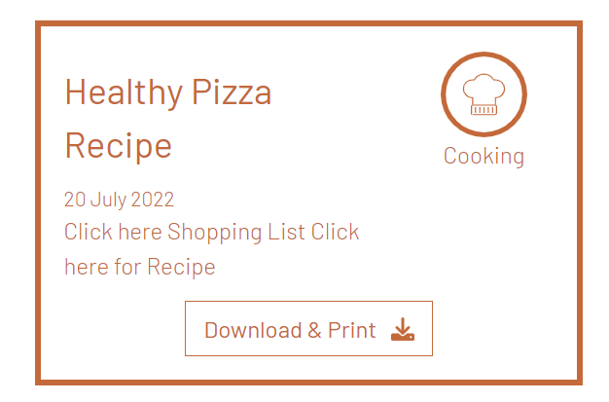
From this

Slide 30
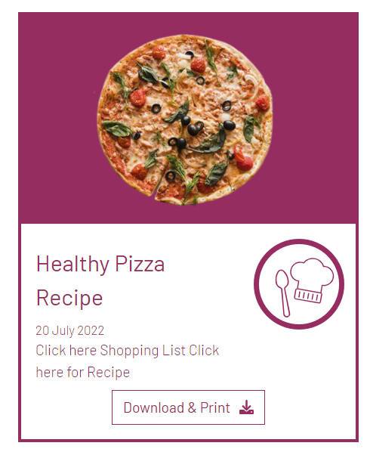
To this

Slide 31
WHAT NEXT?

